Slide 1
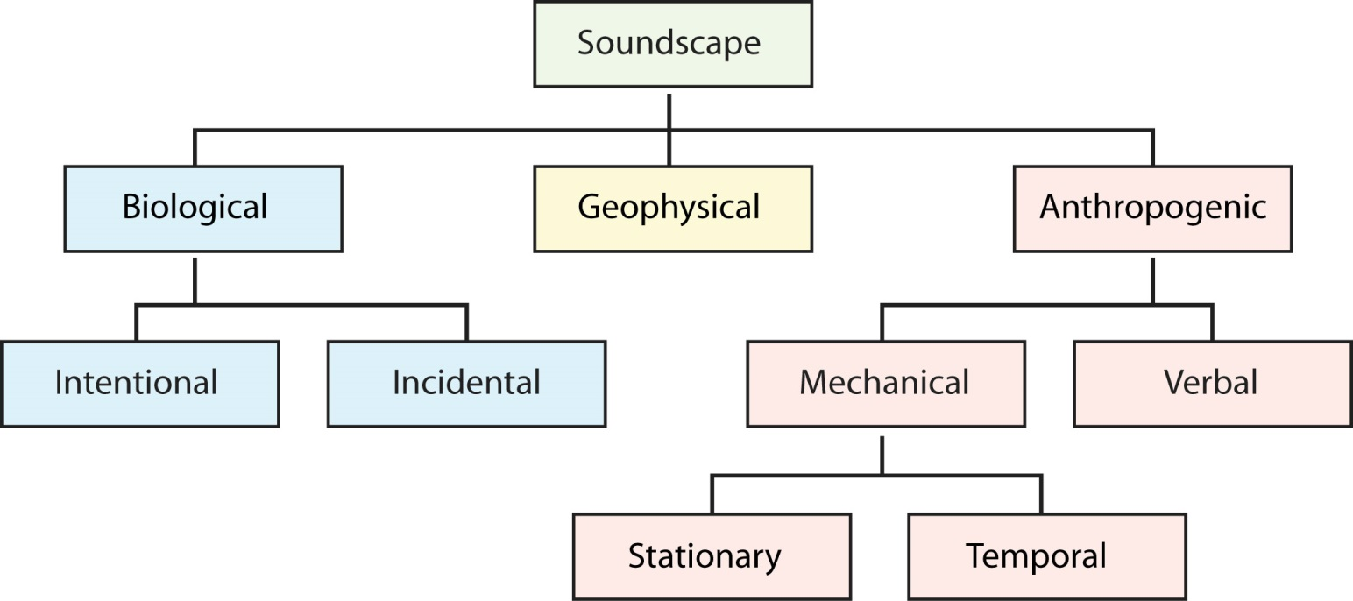
Figure 14.1. An acoustic taxonomic schema of biological, geophysical, and anthropogenic sounds. Anthropogenic verbal communication can also be considered biological, although here they have been categorized separately for clarity.
Gage, S. H., W. Joo, E. P. Kasten, J. Fox, and S. Biswas. 2015. Acoustic observations in agricultural landscapes. Pages 360-377 in S. K. Hamilton, J. E. Doll, and G. P. Robertson, editors. The ecology of agricultural landscapes: long-term research on the path to sustainability. Oxford University Press, New York, New York, USA.
Notes:
Figure 14.1

Slide 2
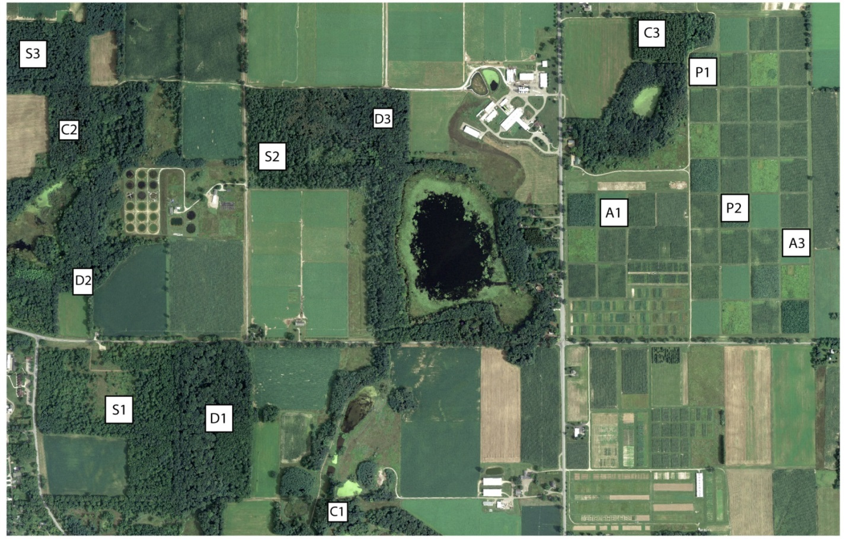
Figure 14.2. Sampling locations at the KBS LTER Main Cropping System Experiment (MCSE) where acoustic tape recorders were deployed from May 18 to July 15, 2005 and set to record six times per day. A = Alfalfa, P = Poplar, C = Coniferous Forest, S = Mid-successional, D = Deciduous Forest.
Gage, S. H., W. Joo, E. P. Kasten, J. Fox, and S. Biswas. 2015. Acoustic observations in agricultural landscapes. Pages 360-377 in S. K. Hamilton, J. E. Doll, and G. P. Robertson, editors. The ecology of agricultural landscapes: long-term research on the path to sustainability. Oxford University Press, New York, New York, USA.
Notes:
Figure 14.2

Slide 3
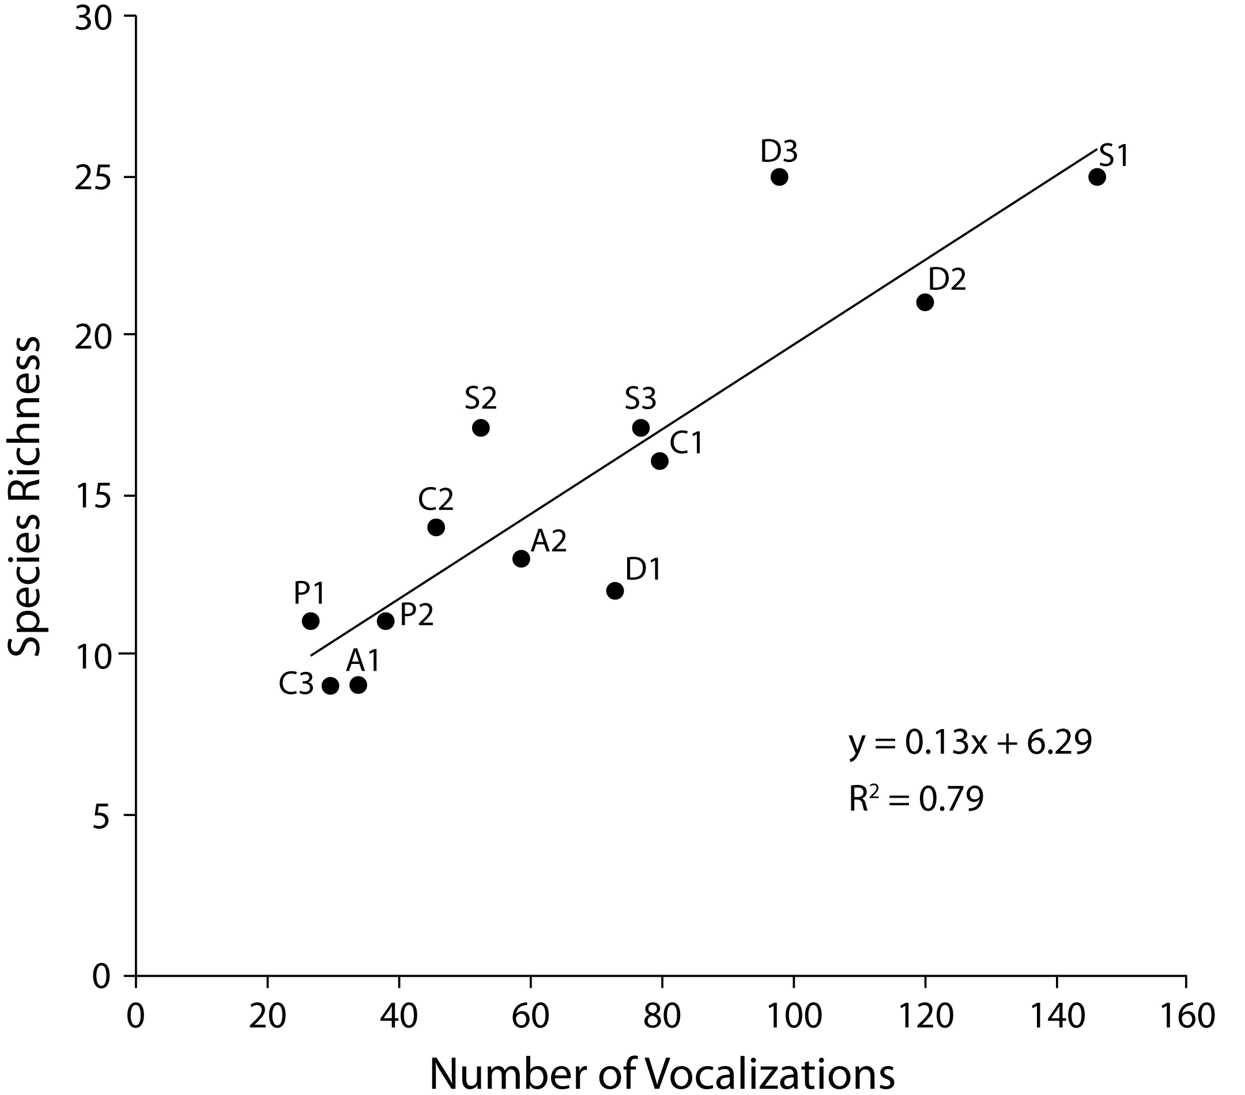
Figure 14.3. The relationship between avian species richness and the number of vocalizations identified from the acoustic samples. The letter and number near each point refers to an MCSE system/replicate number in Figure 14.2.
Gage, S. H., W. Joo, E. P. Kasten, J. Fox, and S. Biswas. 2015. Acoustic observations in agricultural landscapes. Pages 360-377 in S. K. Hamilton, J. E. Doll, and G. P. Robertson, editors. The ecology of agricultural landscapes: long-term research on the path to sustainability. Oxford University Press, New York, New York, USA.
Notes:
Figure 14.3

Slide 4
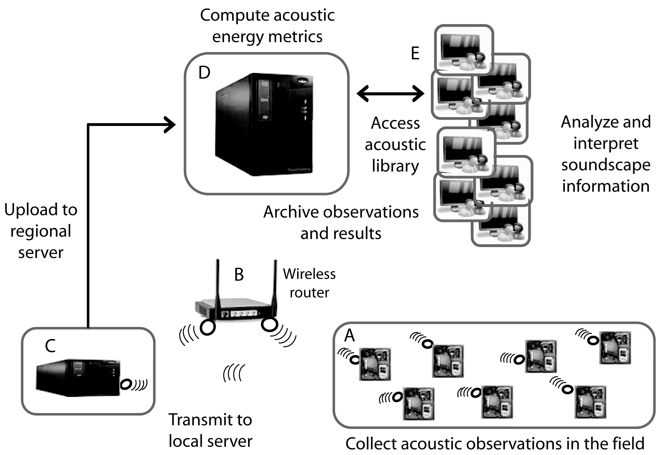
Figure 14.4. The Automated Acoustic Recording System consists of four components: A) acoustic recorders in the field that record sounds at frequent intervals and transmit them using wireless technology, B) one or more wireless routers to relay recordings around tall vegetation, C) a local server to receive the recordings via wireless communication and store them, and D) a regional server where the recordings are received via internet from the local server. The recordings are processed in the regional server and placed in a sound library (E) where they can be accessed.
Gage, S. H., W. Joo, E. P. Kasten, J. Fox, and S. Biswas. 2015. Acoustic observations in agricultural landscapes. Pages 360-377 in S. K. Hamilton, J. E. Doll, and G. P. Robertson, editors. The ecology of agricultural landscapes: long-term research on the path to sustainability. Oxford University Press, New York, New York, USA.
Notes:
Figure 14.4

Slide 5
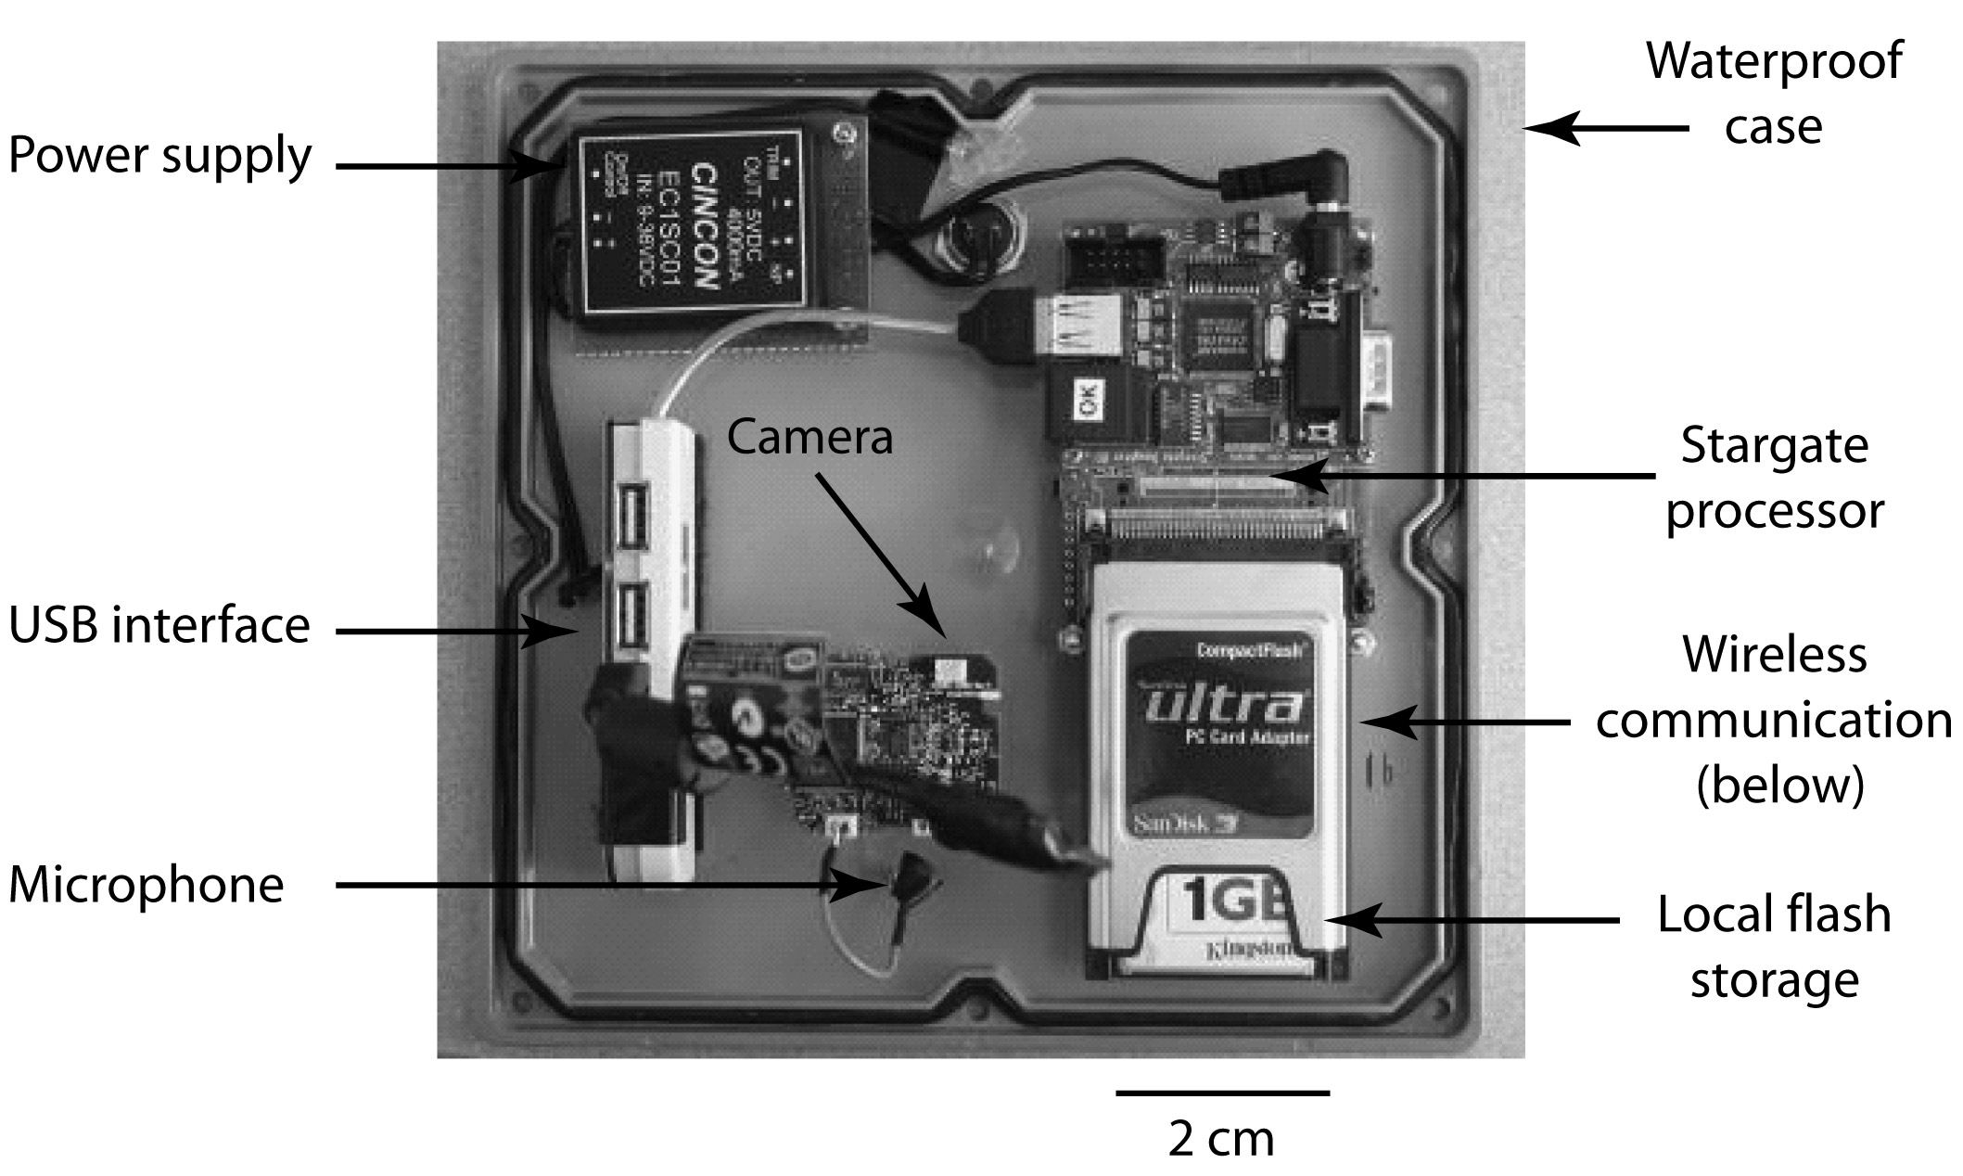
Figure 14.5. The acoustic recorder hardware configuration including a processor, wireless communication, storage, USB interface, power supply, camera, microphone, and a weatherproof enclosure.
Gage, S. H., W. Joo, E. P. Kasten, J. Fox, and S. Biswas. 2015. Acoustic observations in agricultural landscapes. Pages 360-377 in S. K. Hamilton, J. E. Doll, and G. P. Robertson, editors. The ecology of agricultural landscapes: long-term research on the path to sustainability. Oxford University Press, New York, New York, USA.
Notes:
Figure 14.5

Slide 6
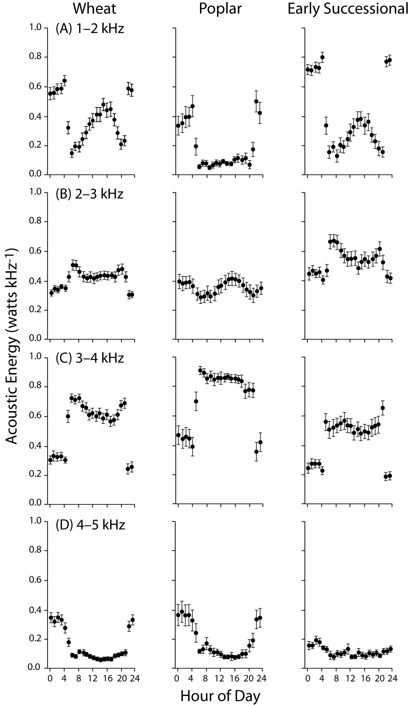
Figure 14.6. The patterns of acoustic energy (watts kHz⁻¹) in each of the examined MCSE systems (Table 14.3) are shown for four different acoustic frequency intervals: A) 1–2 kHz, B) 2–3 kHz, C) 3–4 kHz, and D) 4–5 kHz. Wheat includes both Conventional and No-till systems.
Gage, S. H., W. Joo, E. P. Kasten, J. Fox, and S. Biswas. 2015. Acoustic observations in agricultural landscapes. Pages 360-377 in S. K. Hamilton, J. E. Doll, and G. P. Robertson, editors. The ecology of agricultural landscapes: long-term research on the path to sustainability. Oxford University Press, New York, New York, USA.
Notes:
Figure 14.6

