Slide 1
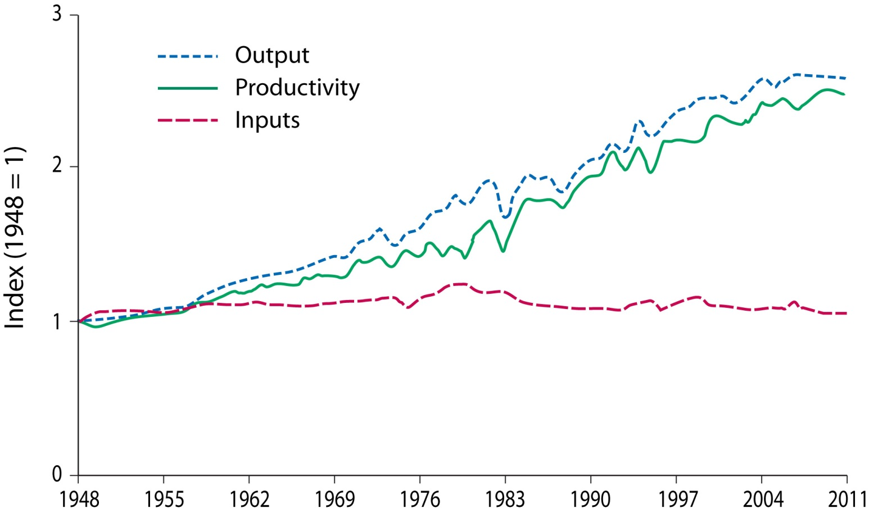
Figure 13.1. Changes in agricultural output, inputs, and total factor productivity in the United States, 1948–2011. Total factor productivity refers to gains in output that were not embodied in added inputs. Redrawn from ERS (2012a).
Swinton, S. M., N. Rector, G. P. Robertson, C. B. Jolejole-Foreman, and F. Lupi. 2015. Farmer decisions about adopting environmentally beneficial practices. Pages 340-359 in S. K. Hamilton, J. E. Doll, and G. P. Robertson, editors. The ecology of agricultural landscapes: long-term research on the path to sustainability. Oxford University Press, New York, New York, USA.
Notes:
Figure 13.1

Slide 2
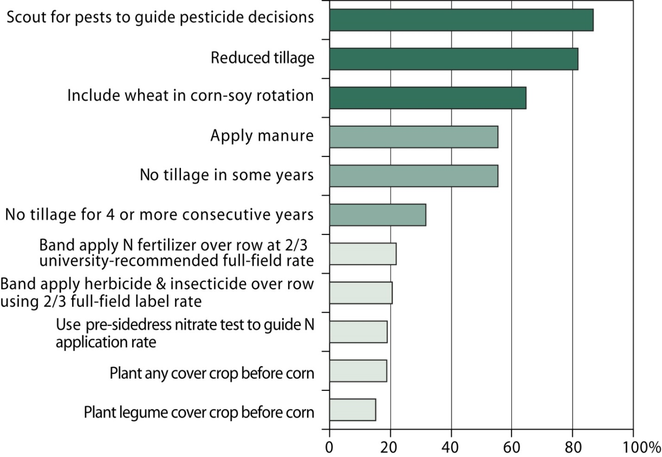
Figure 13.2. Percentage of Michigan corn-soybean farmers reporting current use of selected practices (n = 1408).
Swinton, S. M., N. Rector, G. P. Robertson, C. B. Jolejole-Foreman, and F. Lupi. 2015. Farmer decisions about adopting environmentally beneficial practices. Pages 340-359 in S. K. Hamilton, J. E. Doll, and G. P. Robertson, editors. The ecology of agricultural landscapes: long-term research on the path to sustainability. Oxford University Press, New York, New York, USA.
Notes:
Figure 13.2

Slide 3
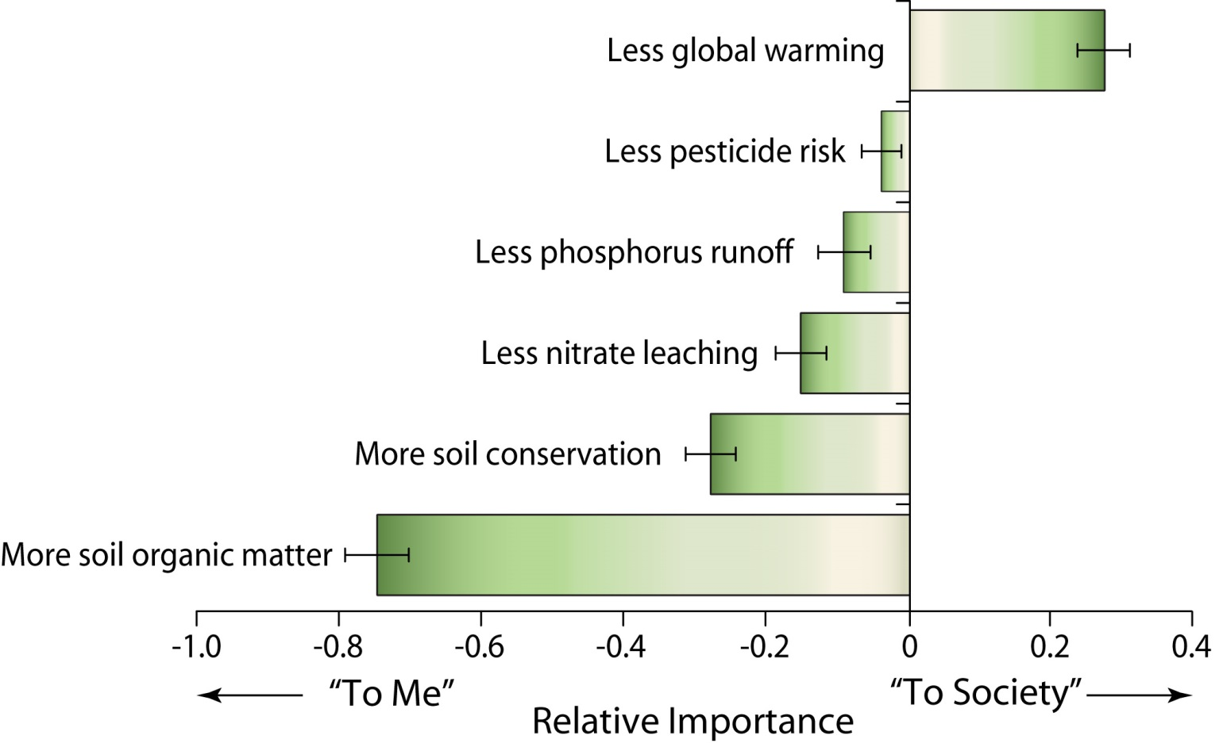
Figure 13.3. Michigan corn-soybean farmer ratings of the importance of the environmental benefits “to me” minus importance of the benefits “to society,” in 2008 (n=1443). Error bars = 2 standard errors based on paired difference t-test. Negative values imply the service was rated more important “to me” than “to society”; positive values indicate the converse. Redrawn from Robertson et al. (2014).
Swinton, S. M., N. Rector, G. P. Robertson, C. B. Jolejole-Foreman, and F. Lupi. 2015. Farmer decisions about adopting environmentally beneficial practices. Pages 340-359 in S. K. Hamilton, J. E. Doll, and G. P. Robertson, editors. The ecology of agricultural landscapes: long-term research on the path to sustainability. Oxford University Press, New York, New York, USA.
Notes:
Figure 13.3

