Slide 1
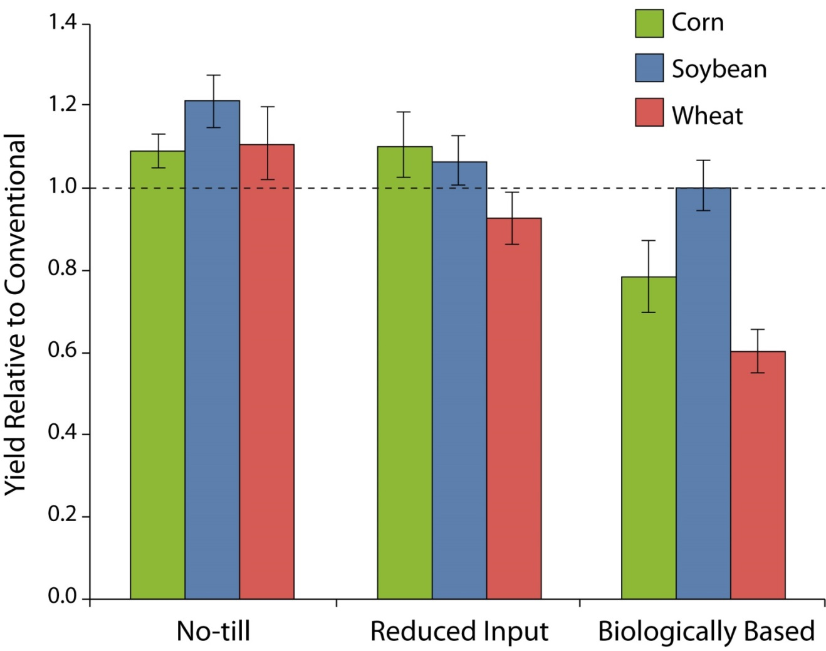
Figure 2.1. Grain yields at KBS LTER under No-till, Reduced Input, and Biologically Based management relative to Conventional management (dotted horizontal line) over the 23 year period of 1989–2012. Absolute yields for Conventional management are similar to county and U.S. national average yields. Error bars represent the standard error. Redrawn from Robertson et al. (2014).
Robertson, G. P., K. L. Gross, S. K. Hamilton, D. A. Landis, T. M. Schmidt, S. S. Snapp, and S. M. Swinton. 2015. Farming for ecosystem services: an ecological approach to production agriculture. Pages 33-53 in S. K. Hamilton, J. E. Doll, and G. P. Robertson, editors. The ecology of agricultural landscapes: long-term research on the path to sustainability. Oxford University Press, New York, New York, USA.
Notes:
Figure 2.1

Slide 2
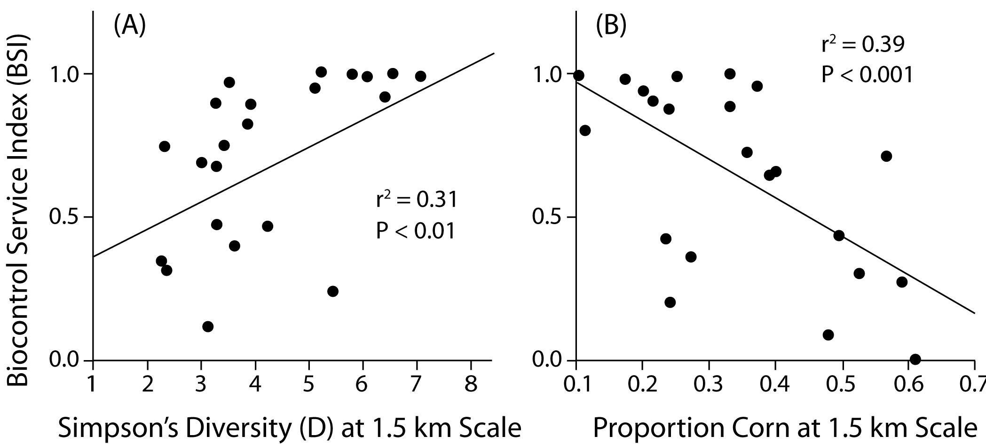
Figure 2.2. Biocontrol services from coccinellids as a function of landscape diversity (A) and the dominance of corn within 1.5 km of soybean fields (B). Panel (A) is redrawn from Gardiner et al. (2009) with permission from the Ecological Society of America; permission conveyed through Copyright Clearance Center, Inc. Panel (B) is redrawn from Landis et al. (2008).
Robertson, G. P., K. L. Gross, S. K. Hamilton, D. A. Landis, T. M. Schmidt, S. S. Snapp, and S. M. Swinton. 2015. Farming for ecosystem services: an ecological approach to production agriculture. Pages 33-53 in S. K. Hamilton, J. E. Doll, and G. P. Robertson, editors. The ecology of agricultural landscapes: long-term research on the path to sustainability. Oxford University Press, New York, New York, USA.
Notes:
Figure 2.2

Slide 3
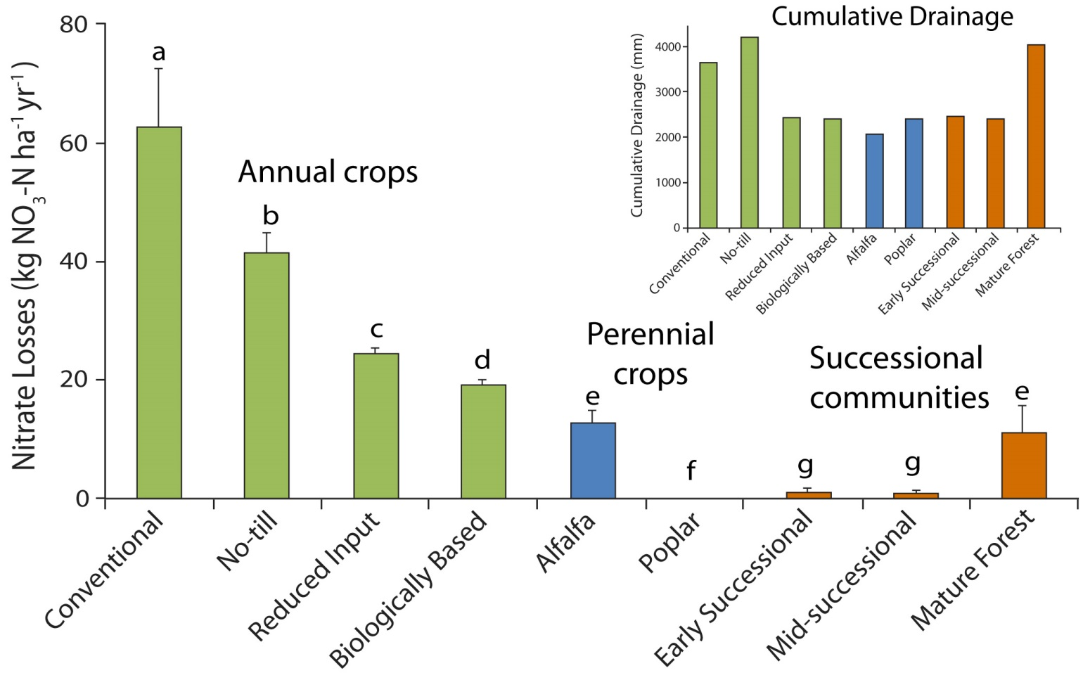
Figure 2.3. Annual nitrate leaching losses and cumulative drainage (inset) from KBS LTER cropping and successional systems between 1995 and 2006. Modified from Syswerda et al. (2012).
Robertson, G. P., K. L. Gross, S. K. Hamilton, D. A. Landis, T. M. Schmidt, S. S. Snapp, and S. M. Swinton. 2015. Farming for ecosystem services: an ecological approach to production agriculture. Pages 33-53 in S. K. Hamilton, J. E. Doll, and G. P. Robertson, editors. The ecology of agricultural landscapes: long-term research on the path to sustainability. Oxford University Press, New York, New York, USA.
Notes:
Figure 2.3

Slide 4
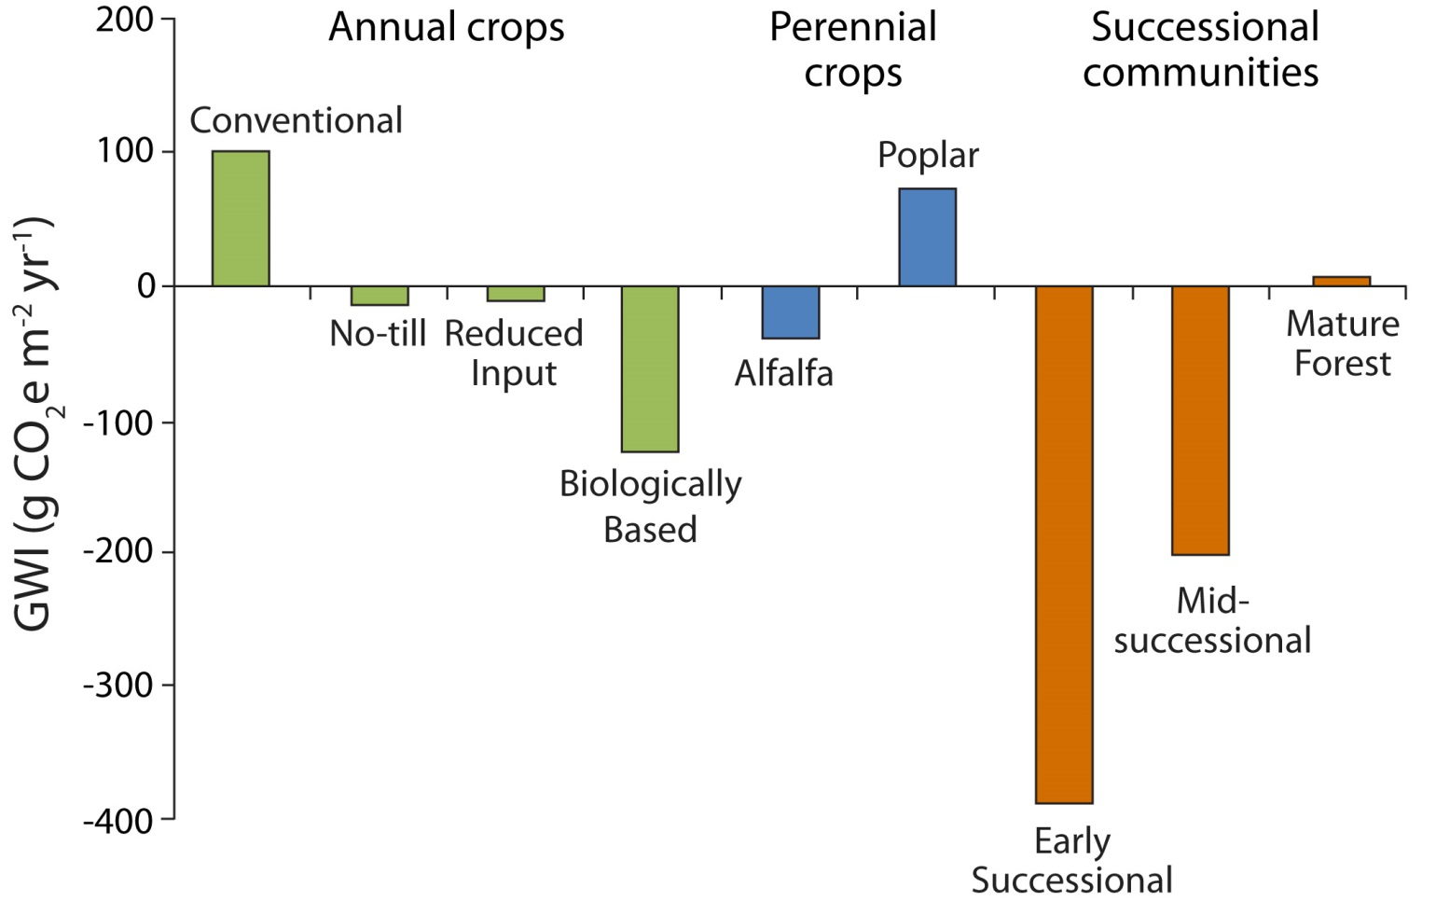
Figure 2.4. Net global warming impact (GWI) of cropped and unmanaged KBS LTER ecosystems. Annual crops include corn-soybean-wheat rotations. Redrawn from Robertson et al. (2014).
Robertson, G. P., K. L. Gross, S. K. Hamilton, D. A. Landis, T. M. Schmidt, S. S. Snapp, and S. M. Swinton. 2015. Farming for ecosystem services: an ecological approach to production agriculture. Pages 33-53 in S. K. Hamilton, J. E. Doll, and G. P. Robertson, editors. The ecology of agricultural landscapes: long-term research on the path to sustainability. Oxford University Press, New York, New York, USA.
Notes:
Figure 2.4

Slide 5
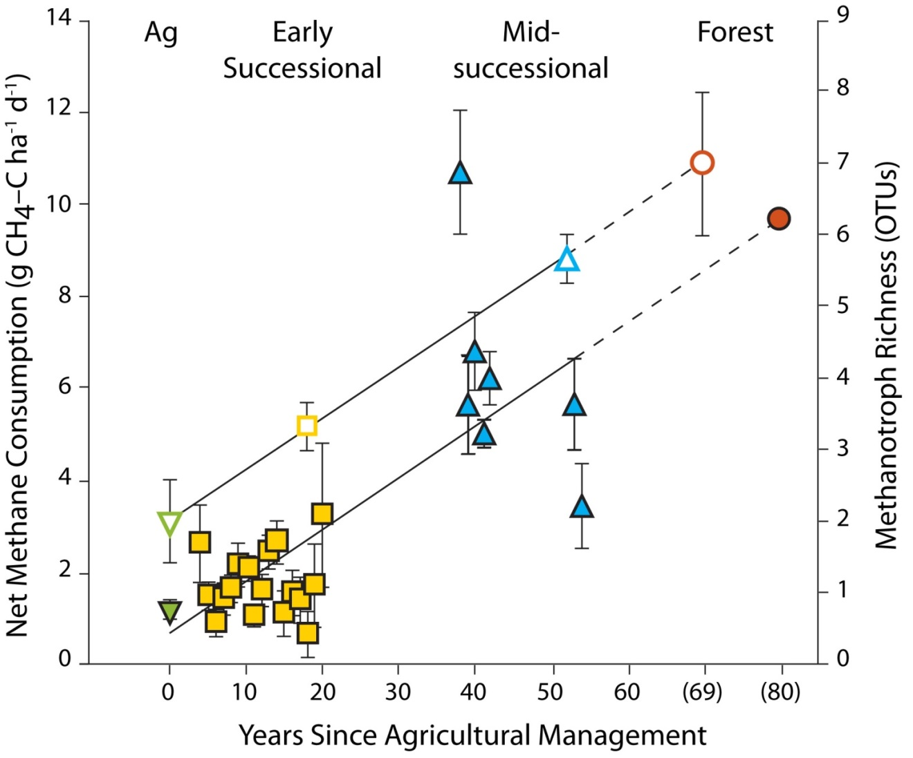
Figure 2.5. The increase in soil methanotroph diversity (open symbols) and atmospheric methane consumption (closed symbols) in ecological succession from row-crop fields (Ag, green) through early (yellow) and mid-successional (blue) fields to mature forest (orange) at KBS LTER. Redrawn from Levine et al. (2011).
Robertson, G. P., K. L. Gross, S. K. Hamilton, D. A. Landis, T. M. Schmidt, S. S. Snapp, and S. M. Swinton. 2015. Farming for ecosystem services: an ecological approach to production agriculture. Pages 33-53 in S. K. Hamilton, J. E. Doll, and G. P. Robertson, editors. The ecology of agricultural landscapes: long-term research on the path to sustainability. Oxford University Press, New York, New York, USA.
Notes:
Figure 2.5

Slide 6
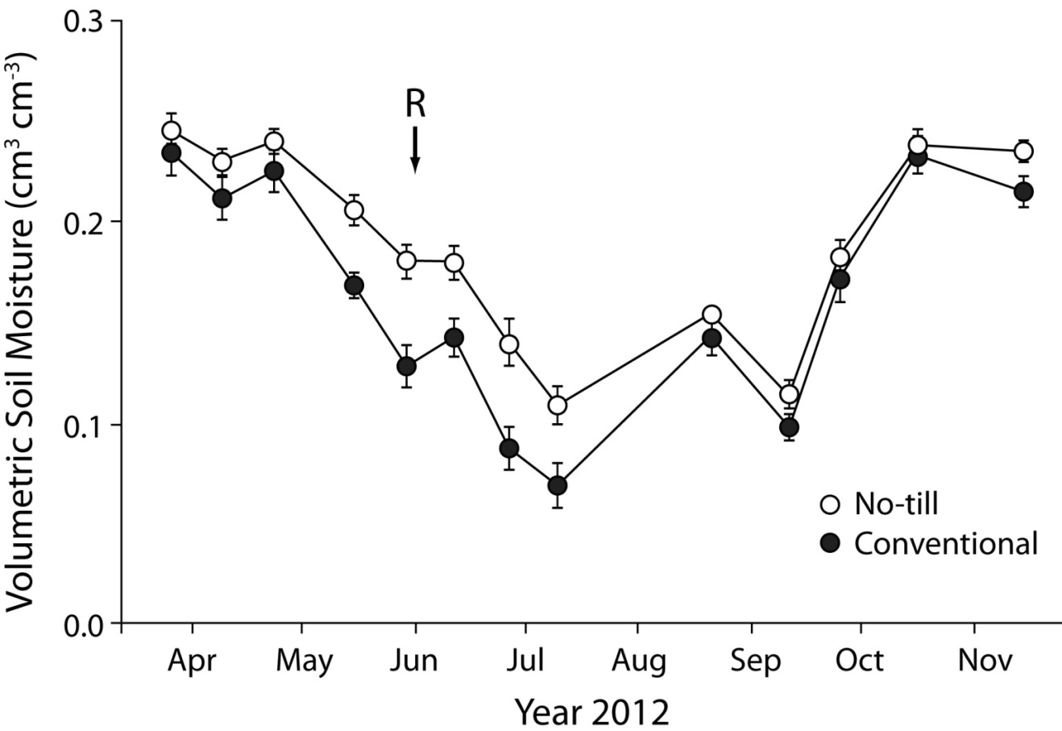
Figure 2.6. Seasonal variation in soil moisture in Conventional and No-till systems during the 2012 soybean growing season. The 6-week drought began after a June 3 rainfall (R on figure). Error bars denote the standard error (n = 6). Redrawn from Robertson et al. (2014).
Robertson, G. P., K. L. Gross, S. K. Hamilton, D. A. Landis, T. M. Schmidt, S. S. Snapp, and S. M. Swinton. 2015. Farming for ecosystem services: an ecological approach to production agriculture. Pages 33-53 in S. K. Hamilton, J. E. Doll, and G. P. Robertson, editors. The ecology of agricultural landscapes: long-term research on the path to sustainability. Oxford University Press, New York, New York, USA.
Notes:
Figure 2.6

Slide 7
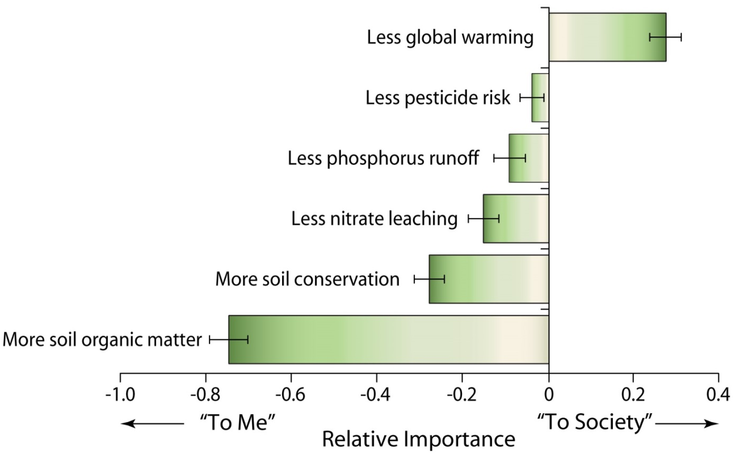
Figure 2.7. The relative importance to Michigan farmers and to society (as ranked by the farmers) of various environmental benefits potentially provided by agriculture. Redrawn from Robertson et al. (2014).
Robertson, G. P., K. L. Gross, S. K. Hamilton, D. A. Landis, T. M. Schmidt, S. S. Snapp, and S. M. Swinton. 2015. Farming for ecosystem services: an ecological approach to production agriculture. Pages 33-53 in S. K. Hamilton, J. E. Doll, and G. P. Robertson, editors. The ecology of agricultural landscapes: long-term research on the path to sustainability. Oxford University Press, New York, New York, USA.
Notes:
Figure 2.7

