Slide 1
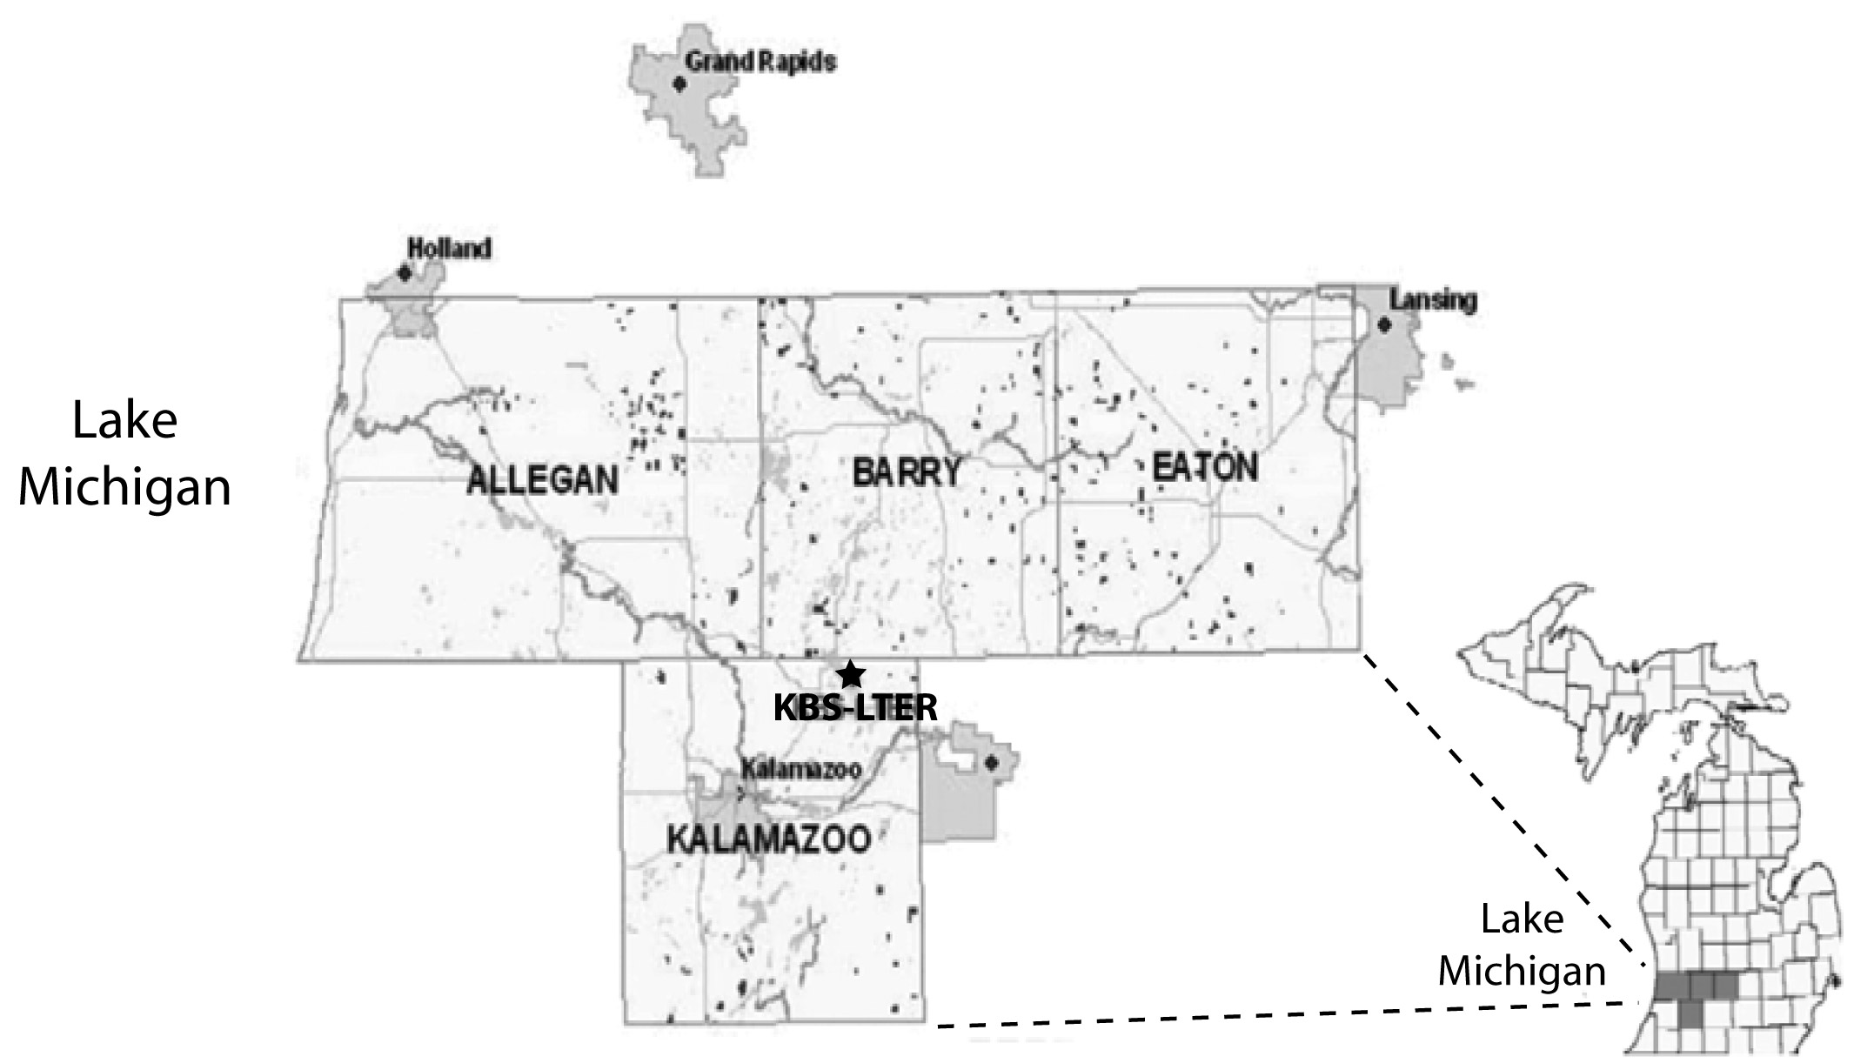
Figure 3.1. Property parcel locations (small black polygons) used in the hedonic study of ecosystem service values embodied in southwestern Michigan land prices. Counties and major cities are also shown. Redrawn from Ma (2010).
Swinton, S. M., C. B. Jolejole-Foreman, F. Lupi, S. Ma, W. Zhang, and H. Chen. 2015. Economic value of ecosystem services from agriculture. Pages 54-76 in S. K. Hamilton, J. E. Doll, and G. P. Robertson, editors. The ecology of agricultural landscapes: long-term research on the path to sustainability. Oxford University Press, New York, New York, USA.
Notes:
Figure 3.1

Slide 2
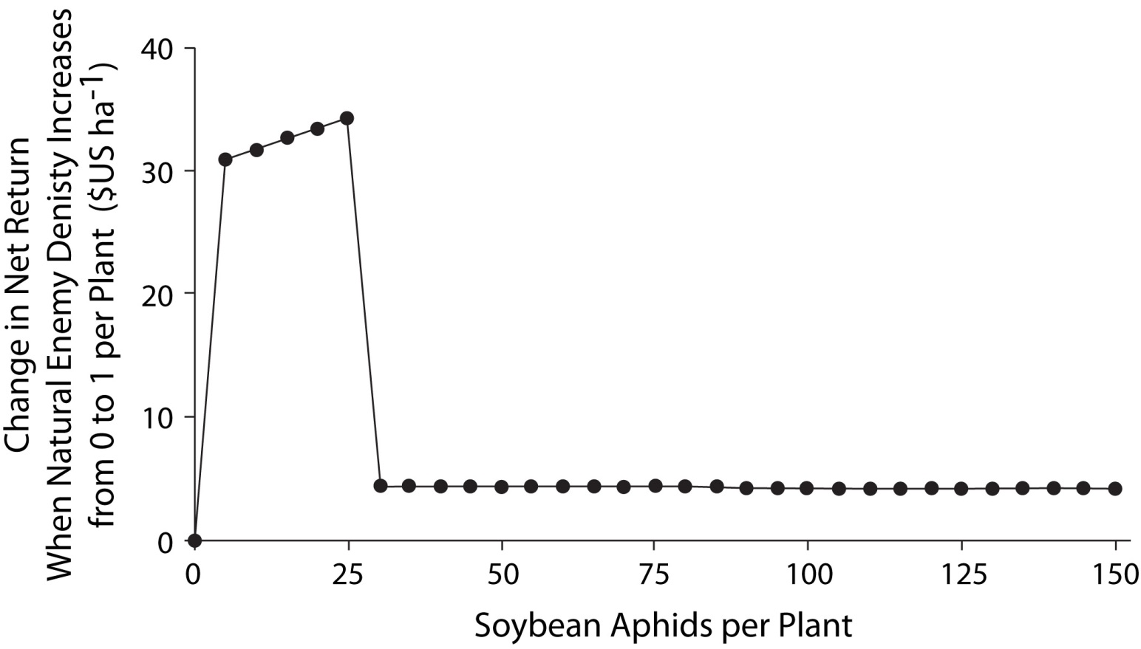
Figure 3.2. Value of one natural enemy per soybean plant (as compared to none) as a function of the abundance of soybean aphids. The aphids are assumed to be in reproductive stage R1, the natural enemy is assumed to have a daily predation rate of 35 aphids, and the initial soybean yield potential is assumed to be 2.69 Mg ha^{–1}. Redrawn from Zhang and Swinton (2012) with permission from Elsevier.
Swinton, S. M., C. B. Jolejole-Foreman, F. Lupi, S. Ma, W. Zhang, and H. Chen. 2015. Economic value of ecosystem services from agriculture. Pages 54-76 in S. K. Hamilton, J. E. Doll, and G. P. Robertson, editors. The ecology of agricultural landscapes: long-term research on the path to sustainability. Oxford University Press, New York, New York, USA.
Notes:
Figure 3.2

Slide 3
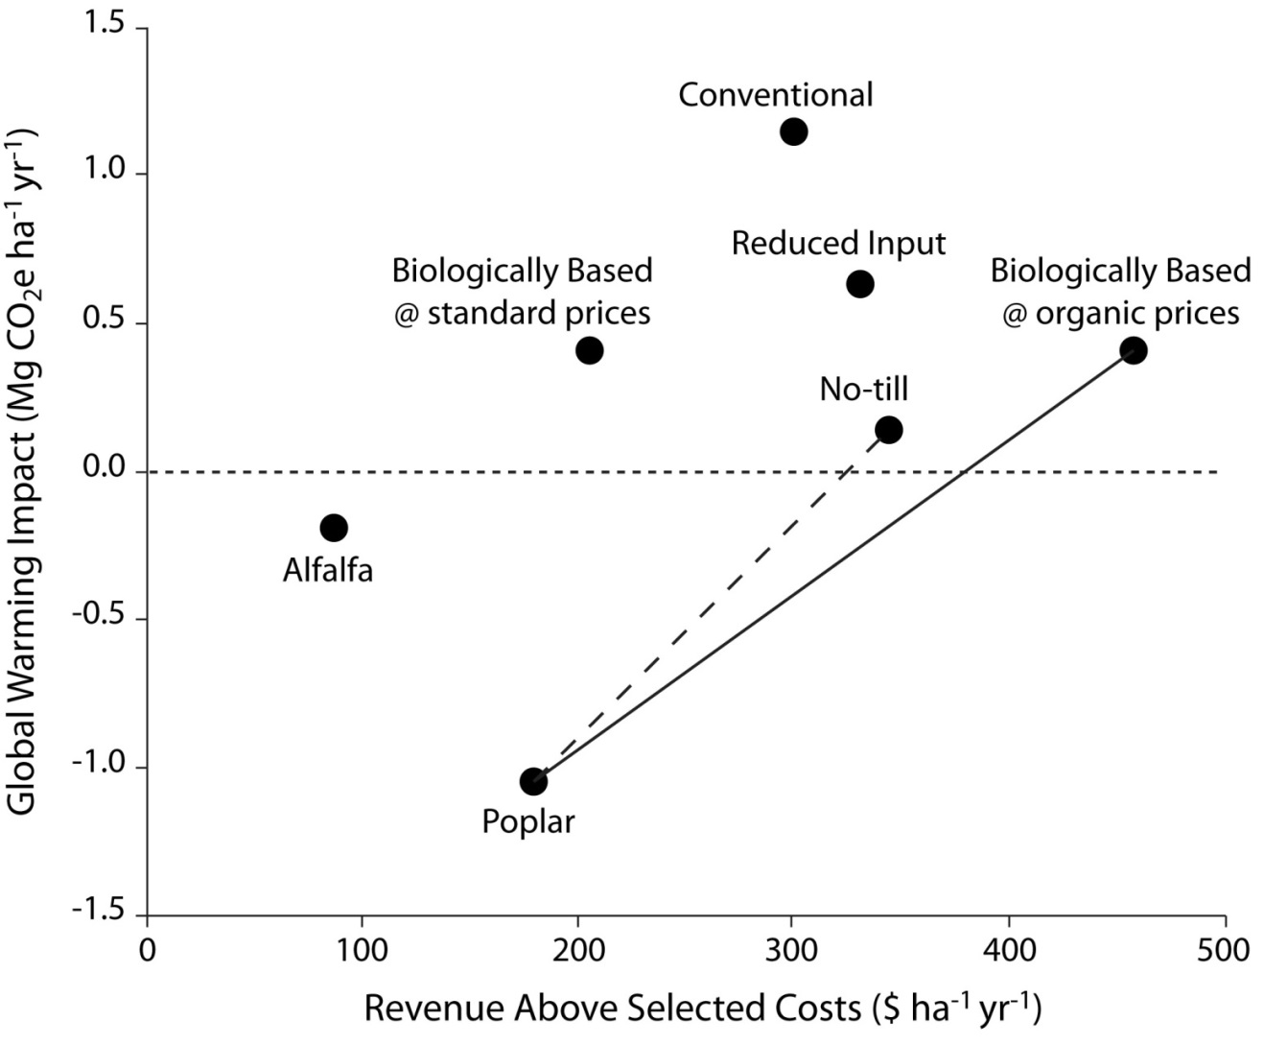
Figure 3.3. Trade-offs between global warming impact (in CO₂ equivalents, CO₂e) and revenue above selected costs for different Main Cropping System Experiment systems, 1993–2007 (except for Alfalfa, 1989–2004 and Poplar, 1989–1998). See text for explanation of lines. Adapted and updated from Jolejole (2009) and Robertson et al (2000).
Swinton, S. M., C. B. Jolejole-Foreman, F. Lupi, S. Ma, W. Zhang, and H. Chen. 2015. Economic value of ecosystem services from agriculture. Pages 54-76 in S. K. Hamilton, J. E. Doll, and G. P. Robertson, editors. The ecology of agricultural landscapes: long-term research on the path to sustainability. Oxford University Press, New York, New York, USA.
Notes:
Figure 3.3

Slide 4
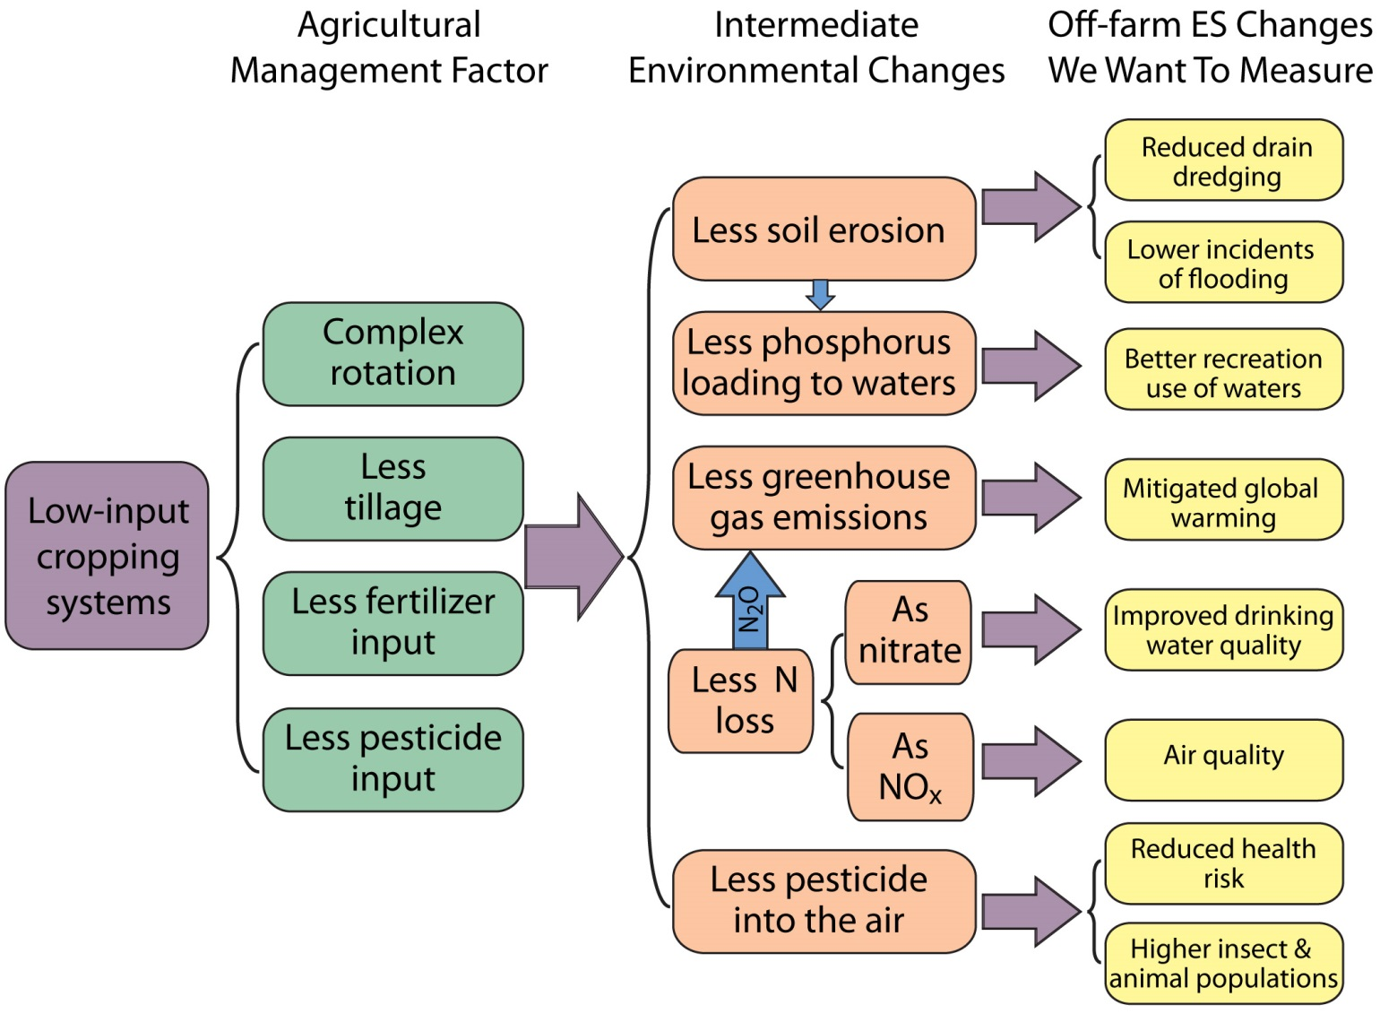
Figure 3.4. Conceptual model of linkages from agricultural management factors to off-farm ecosystem service (ES) changes. Modified from Chen (2010).
Swinton, S. M., C. B. Jolejole-Foreman, F. Lupi, S. Ma, W. Zhang, and H. Chen. 2015. Economic value of ecosystem services from agriculture. Pages 54-76 in S. K. Hamilton, J. E. Doll, and G. P. Robertson, editors. The ecology of agricultural landscapes: long-term research on the path to sustainability. Oxford University Press, New York, New York, USA.
Notes:
Figure 3.4

