Slide 1
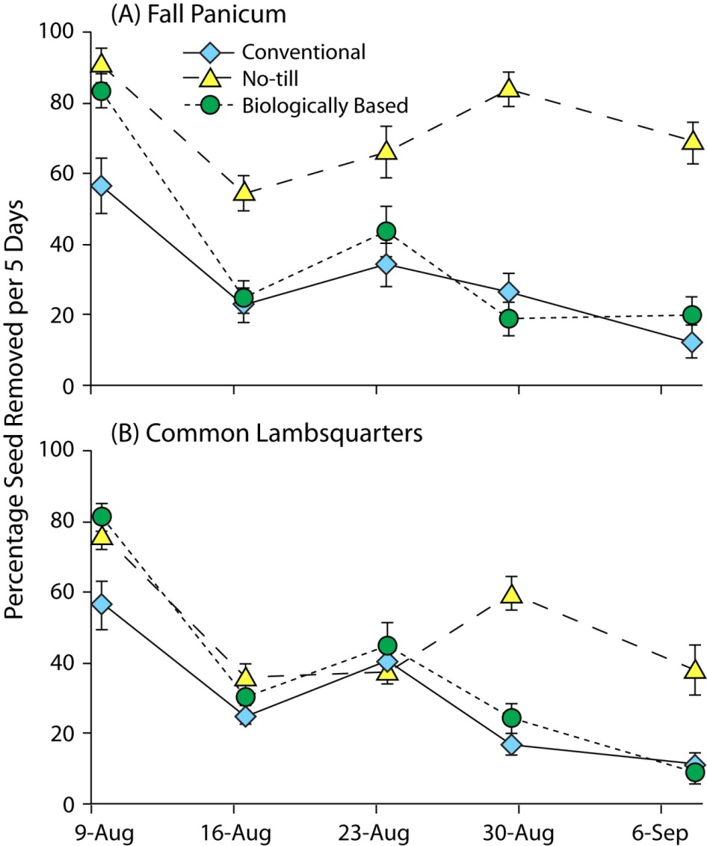
Figure 8.1. Percentage of seeds of (A) fall panicum and (B) common lambsquarters removed by invertebrate seed predators in three KBS LTER Main Cropping System Experiment (MCSE) systems during late summer of 2000 (mean ± SE, n = 6). Each data point represents a five-day period. Redrawn from Menalled et al. (2007) with permission from Elsevier.
Landis, D. A. and S. H. Gage. 2015. Arthropod diversity and pest suppression in agricultural landscapes. Pages 188-212 in S. K. Hamilton, J. E. Doll, and G. P. Robertson, editors. The ecology of agricultural landscapes: long-term research on the path to sustainability. Oxford University Press, New York, New York, USA.
Notes:
Figure 8.1

Slide 2
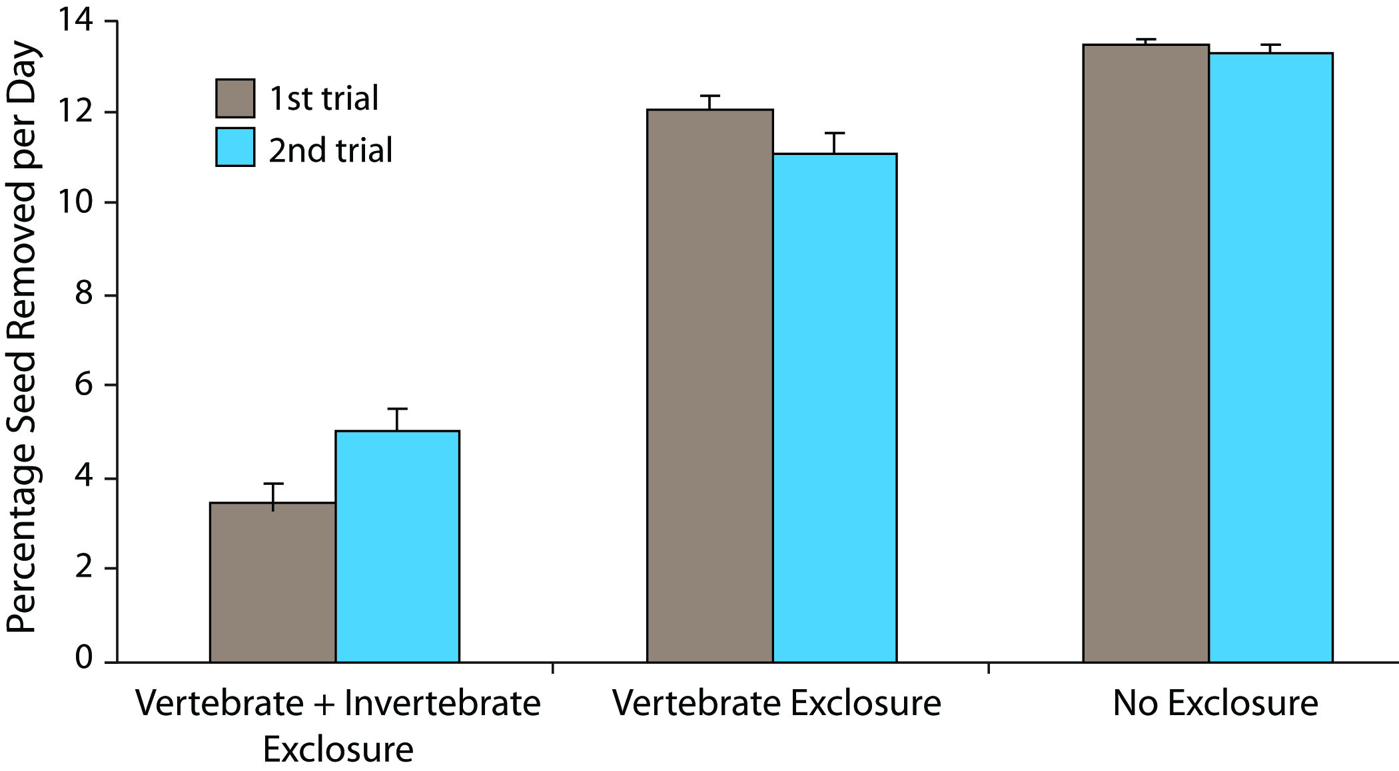
Figure 8.2. Percentage of weed seed removed per day in invertebrate + vertebrate exclosures, vertebrate exclosures, and without exclosure of seed predators (i.e., the control) in two trials averaged across field, species, and landscape type (mean ± SE). Redrawn from Menalled et al. (2000) with permission from Elsevier.
Landis, D. A. and S. H. Gage. 2015. Arthropod diversity and pest suppression in agricultural landscapes. Pages 188-212 in S. K. Hamilton, J. E. Doll, and G. P. Robertson, editors. The ecology of agricultural landscapes: long-term research on the path to sustainability. Oxford University Press, New York, New York, USA.
Notes:
Figure 8.2

Slide 3
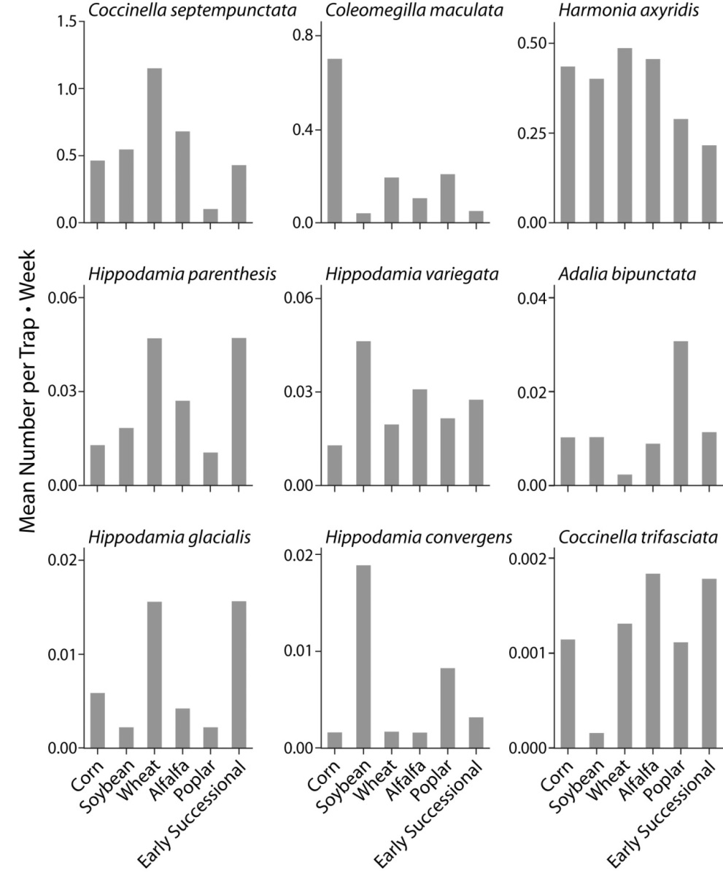
Figure 8.3. Summary of mean number of adults captured per weekly trapping interval for nine ladybird beetle species within different systems of the MCSE over 18 years (1989– 2007). MCSE systems are described in Table 8.1.
Landis, D. A. and S. H. Gage. 2015. Arthropod diversity and pest suppression in agricultural landscapes. Pages 188-212 in S. K. Hamilton, J. E. Doll, and G. P. Robertson, editors. The ecology of agricultural landscapes: long-term research on the path to sustainability. Oxford University Press, New York, New York, USA.
Notes:
Figure 8.3

Slide 4
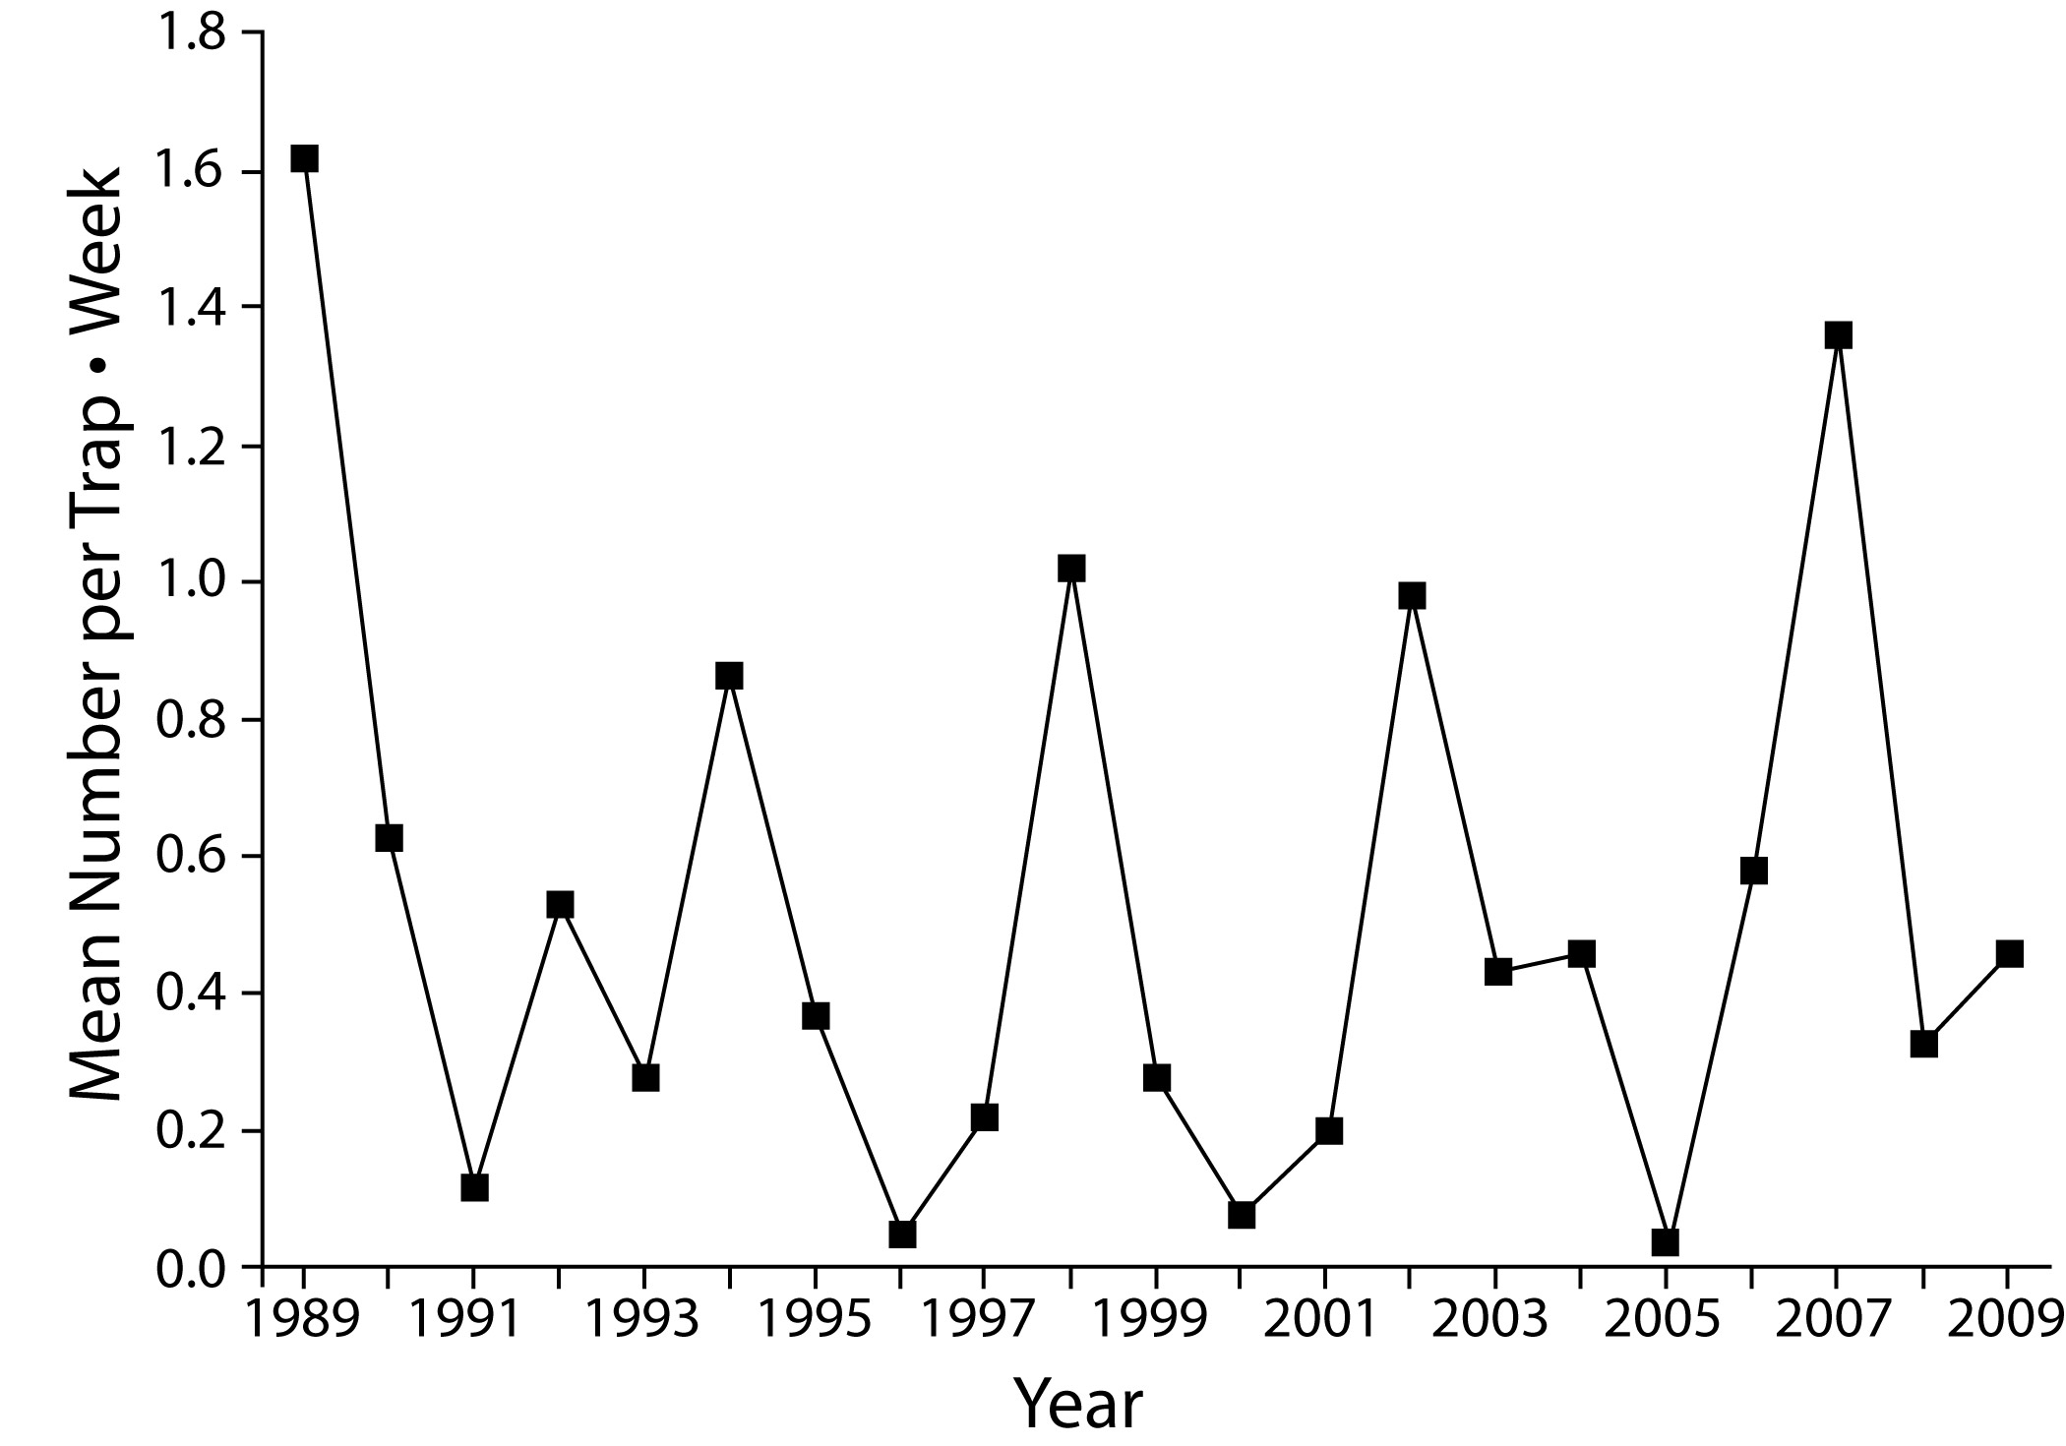
Figure 8.4. Mean number of Coccinella septempunctata ladybird beetle adults caught per trap over week-long deployments at the MCSE between 1989–2009.
Landis, D. A. and S. H. Gage. 2015. Arthropod diversity and pest suppression in agricultural landscapes. Pages 188-212 in S. K. Hamilton, J. E. Doll, and G. P. Robertson, editors. The ecology of agricultural landscapes: long-term research on the path to sustainability. Oxford University Press, New York, New York, USA.
Notes:
Figure 8.4

Slide 5
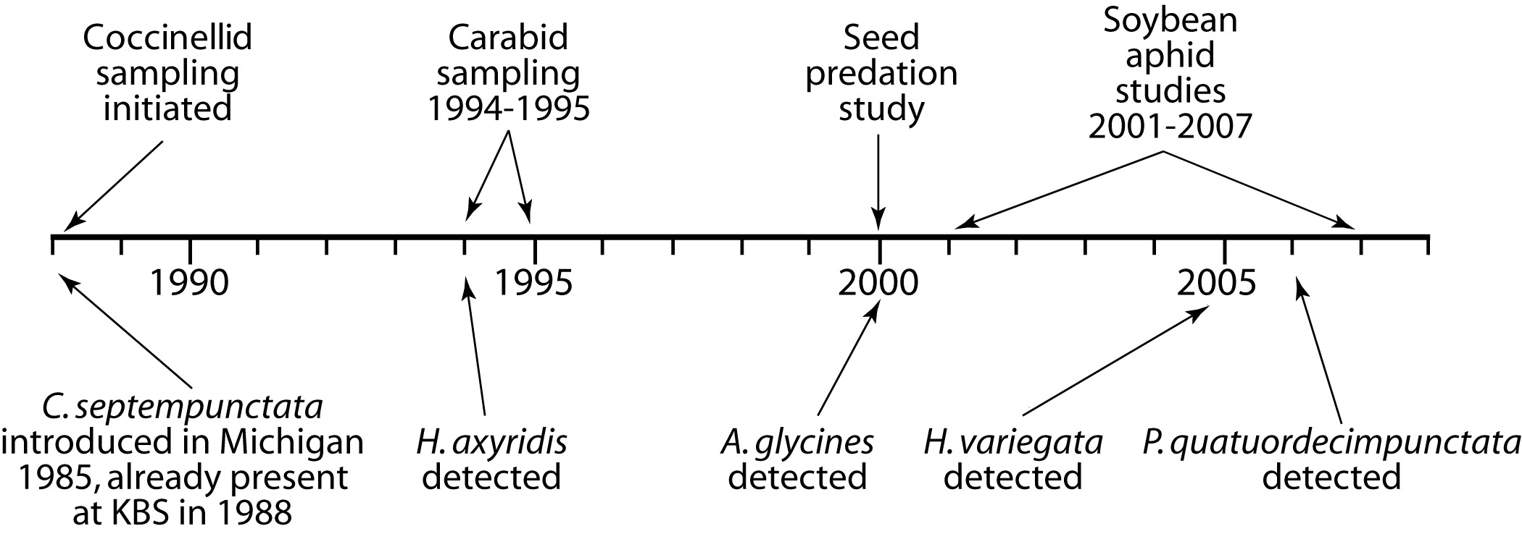
Figure 8.5. Time line showing insect sampling efforts (above line) and the arrival of key exotic coccinellid species (below line) to KBS LTER study sites. See Table 8.2 for full names of coccinellids; A. glycines is the soybean aphid Aphis glycines.
Landis, D. A. and S. H. Gage. 2015. Arthropod diversity and pest suppression in agricultural landscapes. Pages 188-212 in S. K. Hamilton, J. E. Doll, and G. P. Robertson, editors. The ecology of agricultural landscapes: long-term research on the path to sustainability. Oxford University Press, New York, New York, USA.
Notes:
Figure 8.5

Slide 6
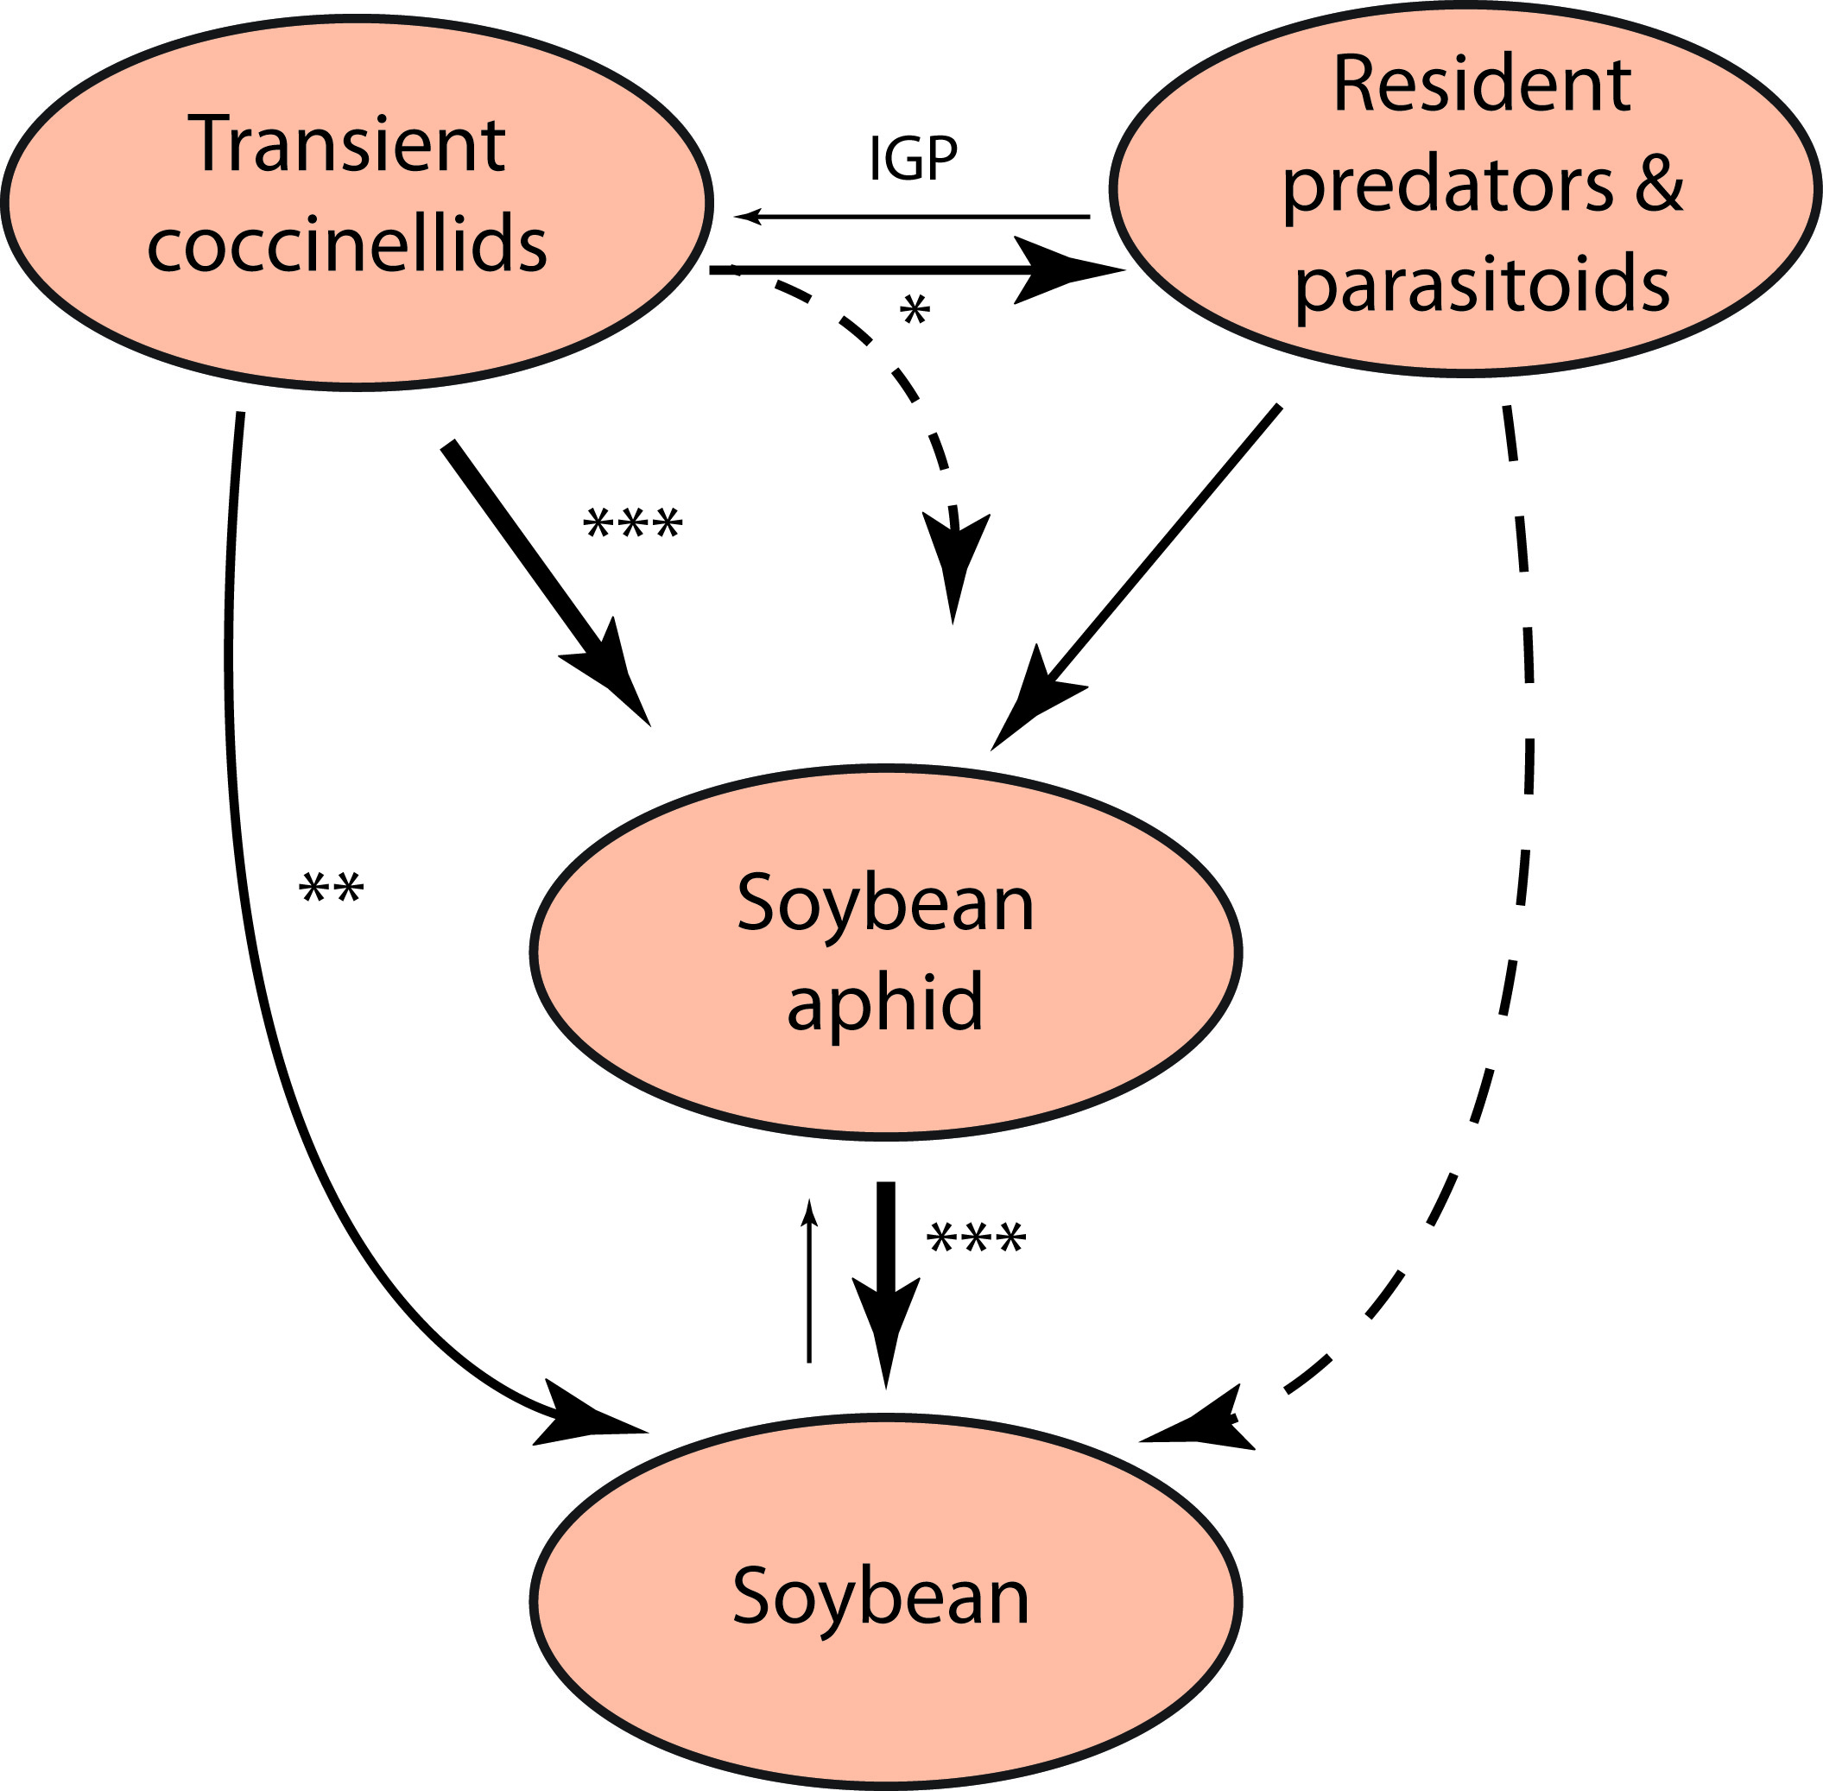
Figure 8.6. Summary of tri-trophic level interactions in the soybean aphid system. Thickness and direction of lines indicate the magnitude and direction of impacts. Dashed lines represent potential interactions that have not yet been shown to occur and asterisks represent increasing levels of statistical significance (P = 0.05 – 0.001). IGP = intraguild predation. Based on Costamagna and Landis (2006), Costamagna et al. (2007a, b, c; 2008), and Gardiner and Landis (2007). .
Landis, D. A. and S. H. Gage. 2015. Arthropod diversity and pest suppression in agricultural landscapes. Pages 188-212 in S. K. Hamilton, J. E. Doll, and G. P. Robertson, editors. The ecology of agricultural landscapes: long-term research on the path to sustainability. Oxford University Press, New York, New York, USA.
Notes:
Figure 8.6

Slide 7
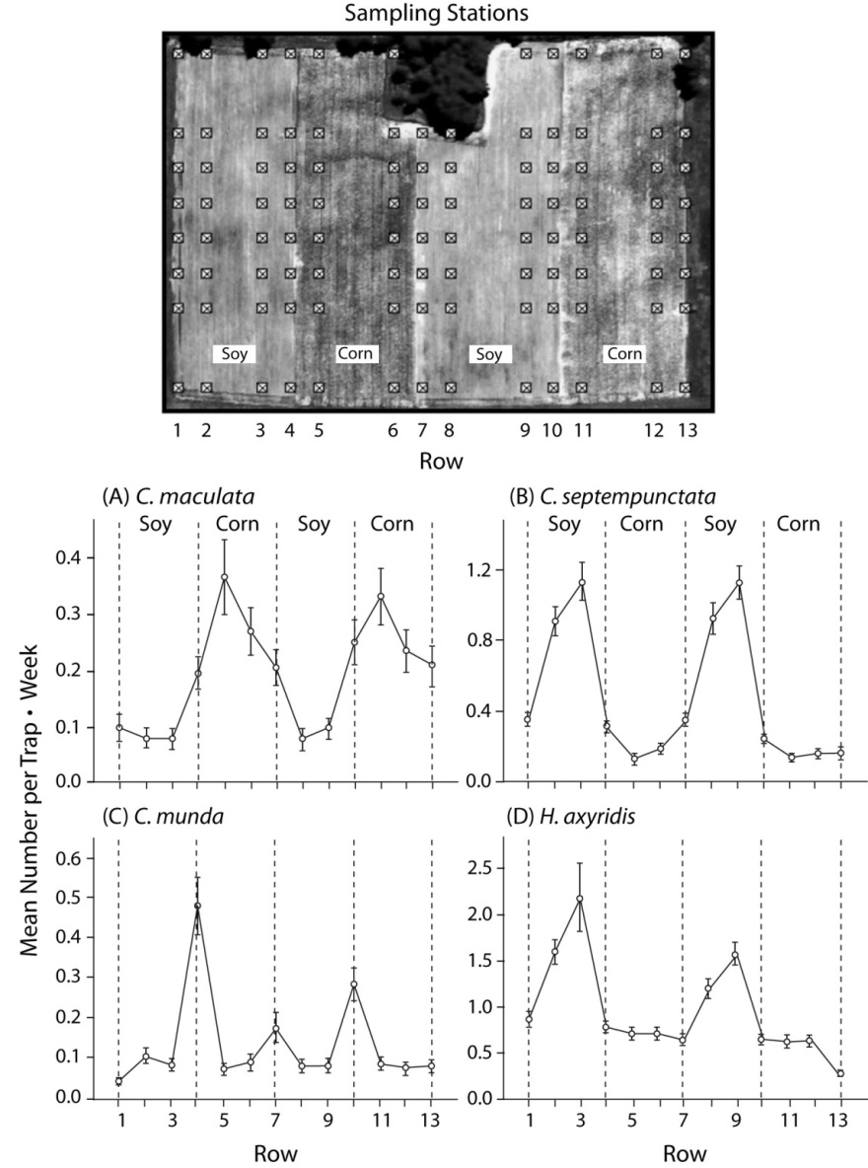
Figure 8.7. Average number of four coccinellid species captured per weekly trapping interval in soybean, corn, and interfacing areas within a large KBS field during 2001. A) Coleomegilla maculata, B) Coccinella septempunctata, C) Cycloneda munda, D) Harmonia axyridis. Aerial photo at top shows configuration of sampling stations. Figures indicate coccinellid abundance (mean ±SE) per crop habitat with rows 1, 4, 7, 10, and 13 representing edge habitats between crops; rows 2, 3, 8, and 9 habitats within soybean; and rows 5, 6, 11, and 12 habitats within corn.
Landis, D. A. and S. H. Gage. 2015. Arthropod diversity and pest suppression in agricultural landscapes. Pages 188-212 in S. K. Hamilton, J. E. Doll, and G. P. Robertson, editors. The ecology of agricultural landscapes: long-term research on the path to sustainability. Oxford University Press, New York, New York, USA.
Notes:
Figure 8.7

Slide 8
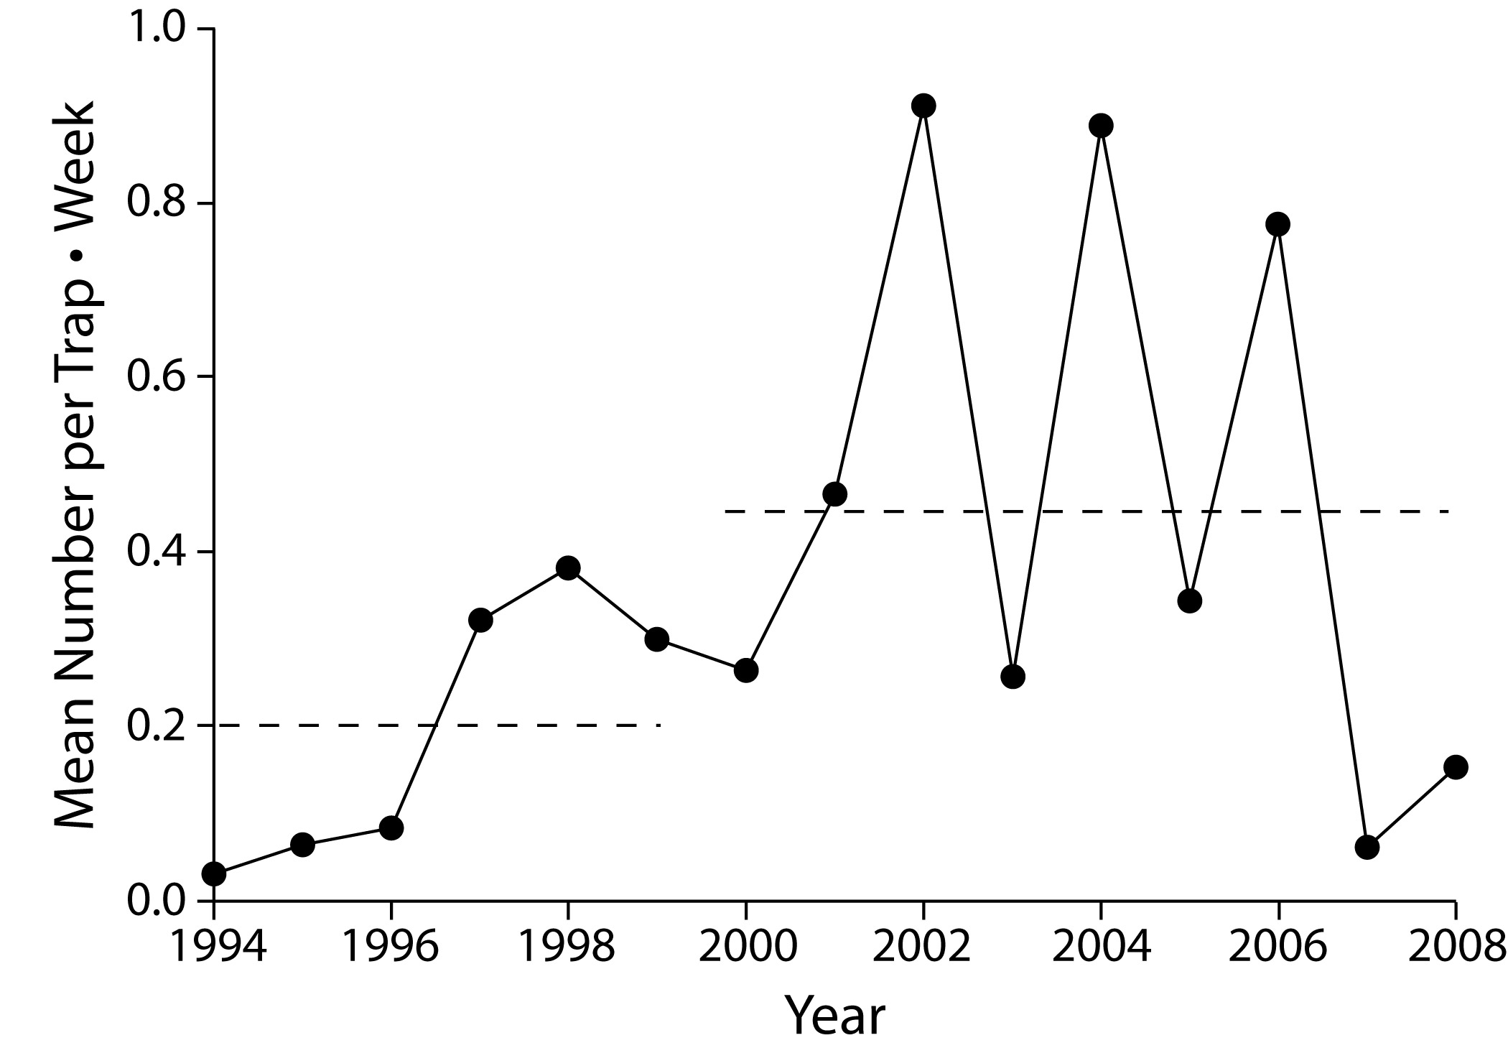
Figure 8.8. Mean number of Harmonia axyridis captured on yellow sticky card traps placed in multiple crop and non-crop habitats at the KBS LTER site, 1994–2008. Dotted lines show the mean numbers of H. axyridis from 1994 to 1999 (before soybean aphid arrival) and from 2000 to 2008 (after soybean aphid arrival). Note the response of H. axyridis following years of local A. glycines outbreaks (2001, 2003, 2005). Redrawn from Heimpel et al. (2010) with kind permission from Springer Science and Business Media.
Landis, D. A. and S. H. Gage. 2015. Arthropod diversity and pest suppression in agricultural landscapes. Pages 188-212 in S. K. Hamilton, J. E. Doll, and G. P. Robertson, editors. The ecology of agricultural landscapes: long-term research on the path to sustainability. Oxford University Press, New York, New York, USA.
Notes:
Figure 8.8

Slide 9
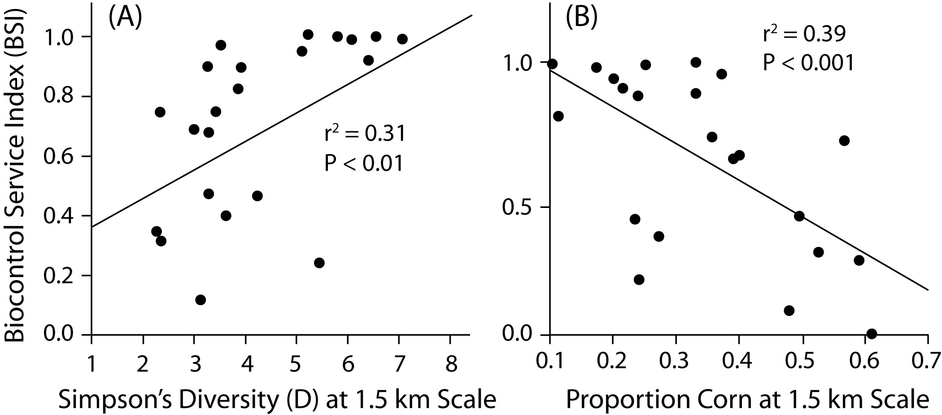
Figure 8.9. Biocontrol services from coccinellids as a function of landscape diversity (A) and the dominance of corn within 1.5 km of soybean fields (B). Panel (A) is redrawn from Gardiner et al. (2009b) with permission of the Ecological Society of America; permission conveyed through Copyright Clearance Center, Inc. Panel (B) is redrawn from Landis et al. (2008).
Landis, D. A. and S. H. Gage. 2015. Arthropod diversity and pest suppression in agricultural landscapes. Pages 188-212 in S. K. Hamilton, J. E. Doll, and G. P. Robertson, editors. The ecology of agricultural landscapes: long-term research on the path to sustainability. Oxford University Press, New York, New York, USA.
Notes:
Figure 8.9

